Slide 1
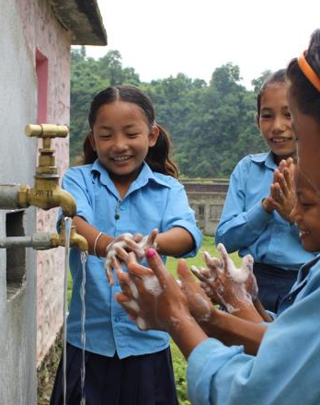
Financing WinS in Nepal
ILE WinS
Nov 11, 2019
Sandhya Chaulagain
WaterAid Nepal
Notes:
Pic Credit: Shruti Shrestha/ WaterAid Nepal

Slide 2
Key outlines
Background and issues
Interventions conducted,
Results and Impact
Key messages and Scale up
Policies
MHM/ WASH in School Progress
Section 9

Slide 3
Background and issues
In 2010
Only 64% of the schools had toilet facilities
Only 40% schools had separate toilet for girls
On an average 127 students had to use one toilet
Policies
MHM/ WASH in School Progress
Section 9

Slide 4
Interventions conducted
In 2010
With the announcement of constructing 10,500 separate toilets for girl students, government allocated NPR 2.5 billion for WinS in 2010 (NPR 1.1 billion for the construction of girl friendly toilets and remaining for external environment improvement)
In between 2010 to 2016 government allocated
NPR 3.7 billion for the construction of girl friendly toilets
NPR 3.7 billion for external environment improvement of the schools
NPR 400 million for the construction of common toilets
NPR 50 million for the management of drinking water in schools
NPR 35 million for the maintenance work
Per unit cost allocation for girl friendly toilet reached to NPR 400 thousand in 2014-2016 from NPR NPR 200 thousand in 2010
Policies
MHM/ WASH in School Progress
Section 9

Slide 5
Results and impact 2016 – 2019: SDG period
Schools with separate toilet for girls increased to 70 % in 2016 from 40% in 2010
School with toilet facilities increased to 85 % in 2016 from 64% in 2010
Girls student to toilet ratio reached to 106 in 2016 from overall students to toilets ratio 127 in 2010
Boy's student to toilet ratio (including common toilet) reached to 47% in 2016
Ratio of school with water supply facility reached to 87% in 2016
With improvement in status -started to allocate budget in single heading ‘WASH Facilities’ from 2016/17 @ NPR 700 million (Toilets with drinking water facilities)
Formulated WinS Procedure 2018; 1 toilet for girl 25 girls and 1 toilet for 40 boys
Policies
MHM/ WASH in School Progress
Section 9

Slide 6
Key messages and Scale up option 2016 – 2030: SDG period
Additional 115 thousand girl friendly toilets are required to meet 1 toilet for 25 girls and 14 thousand boys toilets are required to meet 1 toilet for 40 boys, requiring a total of NPR 91 billion for the period 2016 to 2030 i.e NPR 6 billion per annum
Average budget allocation in WinS per annum is NPR 982 million in the last five years, which is less than one sixth of the requirement to meet the target by 2030.
Government must increase budget in WinS at least by 6 times than the current allocations to meet the target. Sensitization of the issue and orientation of WinS procedure to federal and local governments can be helpful.
Policies
MHM/ WASH in School Progress
Section 9

Slide 7
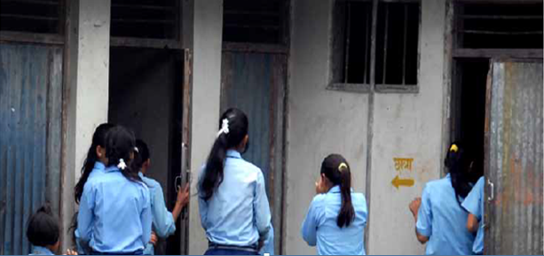
Thank you
Notes:
Is the writing likely to be successful in engaging its intended audience?

