Slide 1


Directorate General of Primary and Secondary Education
Ministry of Education and Culture
Republic of Indonesia
INDONESIAN GOVERNMENT INVESTMENT IN WASH
IN SCHOOLS
Zulkarnaen Haryo Nugroho
Notes:
Good afternoon ladies n gentlemen, it’s great to see u all. My name is Zulkarnaen, I am a delegate from Republic of Indonesia and working for Ministry of education n culture. Although this meeting has been held for the 7th time, but this is the first time for me to attend this convention. Thank You for the opportunity, very happy, and of course a little bit nervous, but hopefully I could give a good contribution for this international Learning Exchange.
In this opportunity I would like to present Indonesian Government investment on WASH in schools/ or what we usually call it WInS.

Slide 2



INDONESIAN EDUCATION SECTOR
in Numbers
Republic of Indonesia
270,393 Schools and Madrasah.
44,857,295 students and 3,453,357 teachers
http://sekolah.data.kemdikbud.go.id/
Notes:
As an introduction, I would like to show you as the fourth most populous countries in the world, Indonesia has more than 270,000 (two hundred seventy thousand) schools and madrasah across the county. In total there are more than 44 million of students of primary and secondary schools with almost 3,5 million teachers supporting them.

Slide 3

School/ Madrasah Health Program
USAHA KESEHATAN SEKOLAH/ MADRASAH
Joint Regulation of the Ministry of Education and Culture, Ministry of Health,
Ministry of Religious Affair, and the Ministry of Home Affairs year 2014:
about development and improvement Usaha Kesehatan Sekolah/Madrasah (UKS/M)
Goals:
To improve the quality of education and learning achievement of students by increasing clean and healthy living behavior and creating a healthy educational environment, so as to enable the harmonious growth and development of students
WASH in Schools is part of UKS/M Program
Notes:
Our Government has a well-established school health program or UKS/M program that has been established since 1950s (ninety fifties). (Just like the batik shirt that I use today). The program is co-managed by four different ministries at national level; Ministry of Education and Culture, Ministry of Health, Ministry of Religious Affair and Ministry of Home Affair. This slide highlight that WASH in Schools is an integrated part of UKS/M program.

Slide 4
UKS/M Stratification since 2000s
MINIMUM
Clean water available
STANDARD
ADVANCED
Fulfill the OPTIMAL Level
OPTIMUM
Fulfill the MINIMUM Level
Fulfill the STANDARD Level
Handwashing facilities in several places with running water and soap
Trash bins in every classroom
Final garbage dump in the school
Improved drinking water source
Handwashing facilities available
Toilets/ latrines available & function
Sewer is functioning properly
Trash bin available
School environment free of mosquito larvae
Improved toilets which are useable and single-sex (meet health and hygiene requirements)
Improved and closed water drainage
Waste is directly transported and thrown to landfills outside the school
Proportion ratio of toilets to students 1:20
Notes:
Under the UKS/M or school/madrasah health program, since early 2000s (two thousands), Government of Indonesia has developed a stratification system. This system divides a school status into four different rank; first the lowest one is minimum; and then standard; after that optimum and the highest one is advance. This stratification is quite similar with Three Stars Approach, but more comprehensive as it also covers other program, such as nutrition, child-friendly schools, Periodic health examinations, etc. As you can see, the UKS strata also set WASH in Schools criteria that need to be fulfilled by schools.

Slide 5

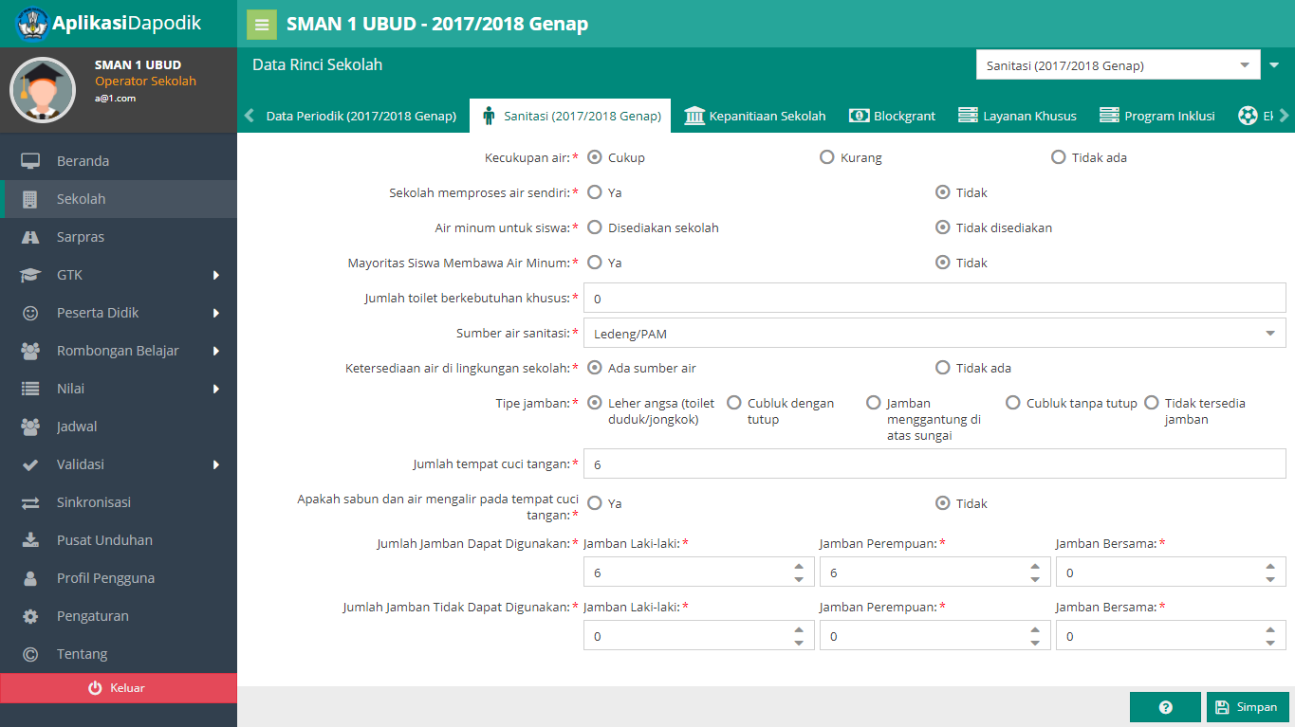

What Trigger WASH in Schools Investment
1. WinS Profile that Shows
Where are we now? Disparities across education level and locations
2017
National Education Management Information System (EMIS)
Notes:
So, What trigger WASH in Schools Investment? This is a very good question. We believe the significant amount of investment on WinS that has been allocated by Government of Indonesia was a result of Data Driven Policy Advocacy. In 2016 (two thousand sixteen), Ministry of Education and Culture incorporate several basic questions/indicators on the existing Education Management Information System (EMIS). This Information System in Indonesia is called DAPODIK.
The data was analyzed in 2017 (two thousand seventeen) to show the current condition of WASH in Schools facilities in Indonesia. We compiled into school sanitation profile 2017. The data analysis was an eye-opened as it was put against the standard on WinS.
You can see from the infographic, 12% schools do not proper toilet. One out of three schools do not have handwashing facility, and one out of two schools do not have gender-separated toilets. This condition has created a long queue for students to use toilet during their breaktime. Nationally, the toilet ratio is 1:122 for boys and 1:117 for girls.

Slide 6
2. Roadmap That Shows Strategies and Investment Needed to Achieve SDGs on WinS
ROADMAP OF SCHOOL SANITATION
WITHIN UKS FRAMEWORK 2017
USD 1,044,415,444
Notes:
After we know the current situation, with technical support from various development organization, we developed a roadmap, a planning document that provide guidance on how we could achieve SDGs target on WinS. And most importantly, how much the investment cost that we may need to achieve this target. A simple calculation has been made and reflected in roadmap, which show that Indonesia may need at least USD 1,044,415,444 (more than one Billion USD) to achieve SDGs in several years ahead.

Slide 7
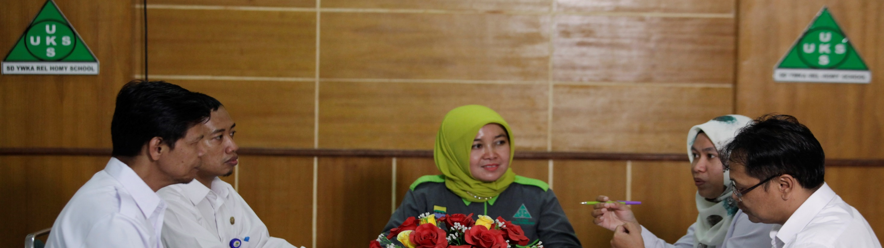

What are the challenges
National Government Allocation (APBN)
  National Government Support (Bantuan Pemerintah)
  School Operational Fund: allocated for activities & WASH O&M
Local Government (Province and District) Allocation (APBD)
  General Allocation Fund (DAU)
  Special Allocation Fund (DAK): allocated for new latrine construction & rehabilitation
WinS
WinS
How to Align with Existing Financial Instrument For Education Sector
Notes:
After we know the investment needed to pursue the target, the main challenge was on how to allocate investment on WinS. Rather than having a specific financing mechanism, we use the existing government financial instrument and insert WinS component on those instruments. Government of Indonesia has several instruments on Education sector, whether at national government level (APBN) or at the local government level (APBD). Among many financial instruments, WinS is inserted at least in two biggest portion of Education funding, which is School Operational Fund at national level and Special Allocation fund at local government level.

Slide 8
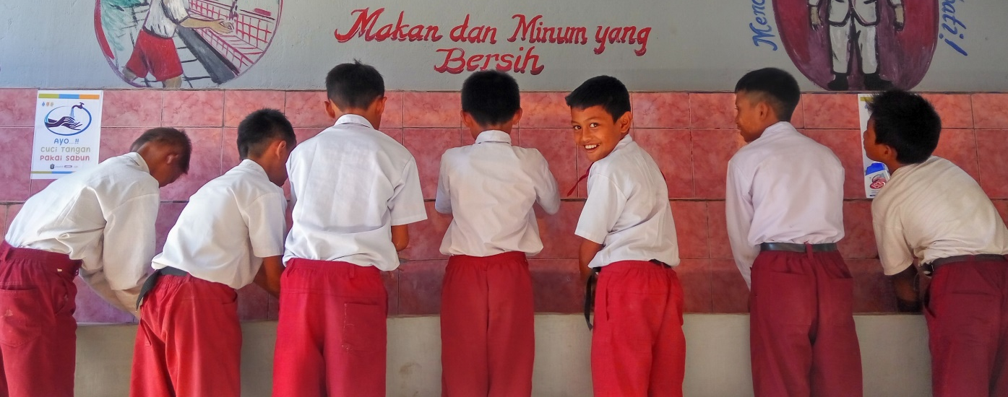


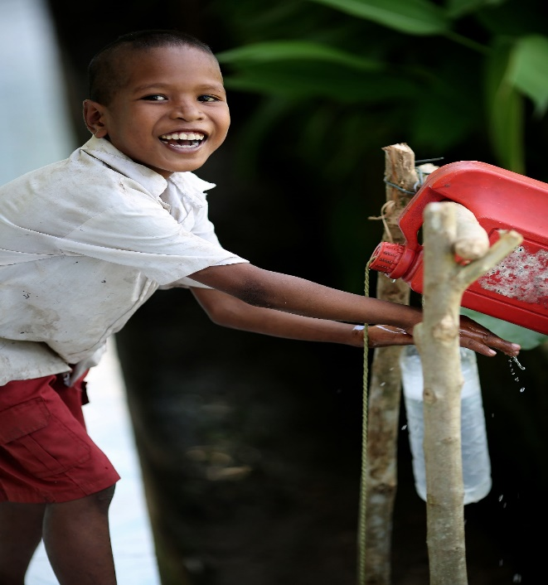
  School Operational Fund
Introduced in 2005
To cover personnel and non-personnel cost at school level
  Personnel (additional teachers, admin staffs, janitor etc)
  Non Personnel : consumables, power, water, telecommunications, minor repairs,
  overtime, transport, consumption, tax, insurance, etc)
Since 2017 :
WASH in Schools eligible costing line on BOS
  Activities, such as handwashing
  Operation and maintenance of WinS facilities
  Small rehabilitation
Level | BOS per Student Annually
Primary Education (SD/MI) | USD 57
Secondary Education (SMP/MTs) | USD 71,5
Higher Education (SMA/MA) | USD 100
Vocational Education | USD 114
Special Education | USD 143
Notes:
Bantuan Operasional Sekolah (BOS), or School Operational Fund is used mainly to cover school daily need, such as consumables, power, water, telecommunications, minor repairs, overtime, transport, consumption, etc.
Since 2017, based on Ministry of Education and Culture regulation, WASH in Schools become an eligible costing line on BOS. Therefore, by creating an eligible costing line on BOS, all 270,393 (two hundred seventy thousand) schools and Madrasah in Indonesia could use it to fund WinS activities such as handwashing, Operation and maintenance cost of WinS facilities, as well as small rehabilitation

Slide 9
Special Allocation Fund for Education Sector (DAK)
Part of broader DAK fund for local government
(Health, Water, Sanitation, and Education)
To cover large infrastructure cost, such as construction classrooms, library, laboratory, etc
Since 2018 WASH in Schools allocation become significant
  Construction new WinS facilities
  Rehabilitation of existing WinS facilities
Notes:
Special Allocation Fund or DAK is actually part of broader DAK fund for local government, that also available for Health, Water, Sanitation, and environmental sector. DAK on Education is usually to cover large infrastructure cost, such as construction classrooms, library, laboratory, etc.
Since 2018 (two thousand eighteen) WASH in Schools allocation become an official menu of DAK Education and starting in 2018 the allocation for Construction new WinS facilities and Rehabilitation of existing WinS facilities increase significantly from USD 343,710 (three hundred forty three thousand USD) in 2016 to USD 75,702,100 (seventy five million USD) in 2019.

Slide 10


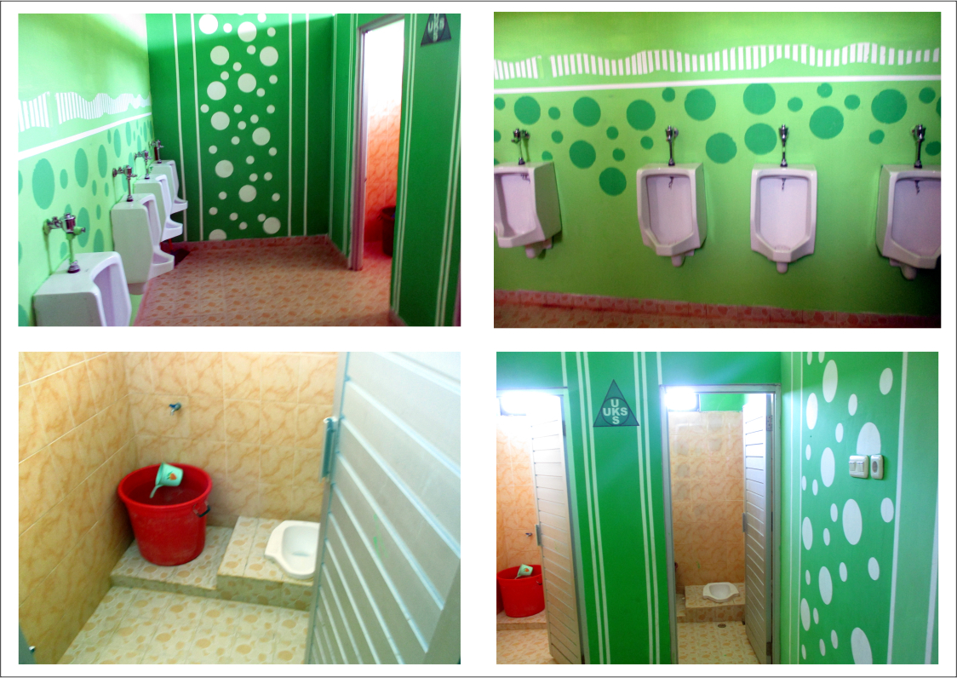
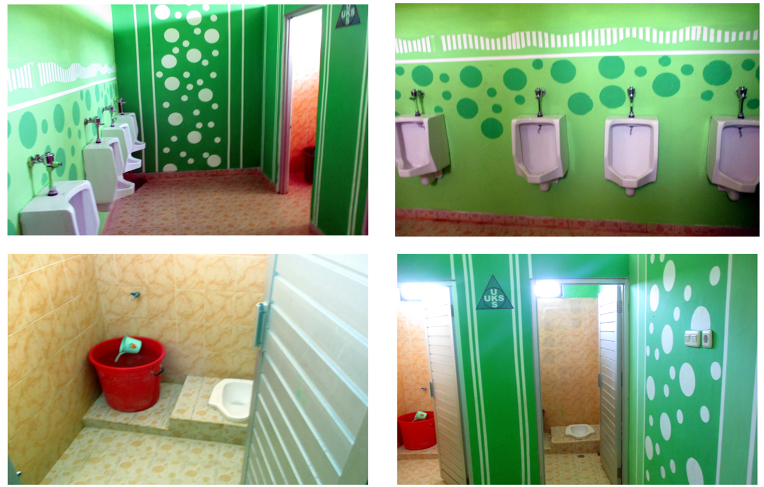
Improvement of Access to WinS facilities 2017 vs 2019
Toilet Ratio
2017 | 2019
122 | 107
2017 | 2019
117 | 101
Notes:
The significant amount of funding by the government has proven to improve the access to WinS facilities. As you can see from the slide, access to water, sanitation and hygiene are improving for the last two years. The average toilet ratio at national level also reduce for both boy and girl.

Slide 11
What advise to other countries
Data driven policy advocacy
Maximizing or make use of existing government program platform --> UKS/M
Insert WinS on the existing government financial instrument --> BOS and DAK
Notes:
As summary and also advise for other countries, we would like to highlight three points. First, we believe that good quality of data could drive policy change.
Secondly, rather than developing a new platform, as much as possible, use the existing government program platform. In this case, we use the existing UKS program.
Lastly, we encourage to explore the possibility to use the existing government financial instrument and leverage it to advance WinS development sector.

Slide 12
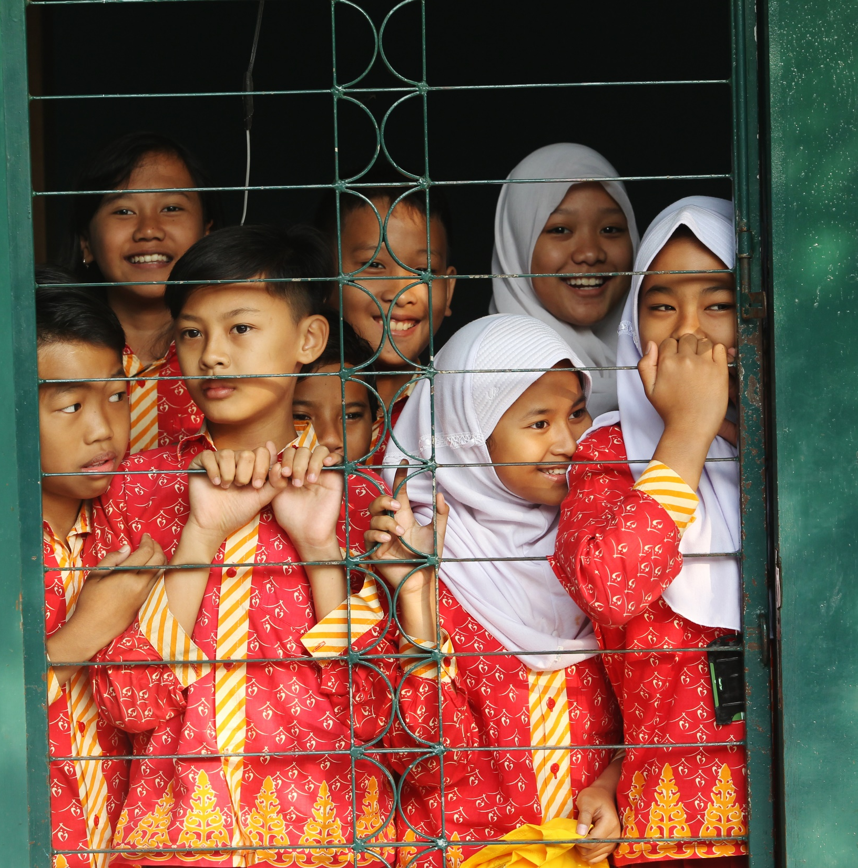

Republic of Indonesia
Thank You
Salamat
Terima Kasih
Notes:
Thank you very much for your great attention, ladies and gentlemen. May all those we have shares be beneficial for all of us.

