Slide 1
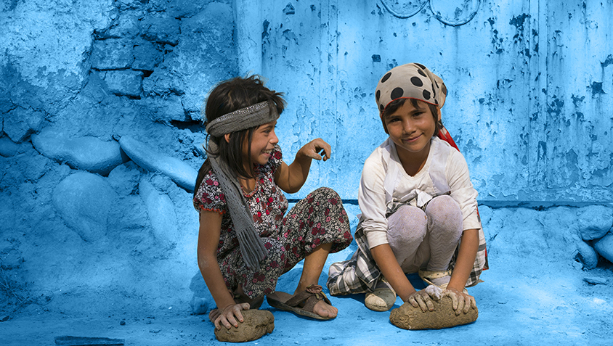

November, 2019
WINS FINANCING
© UNICEF/Lister

Slide 2
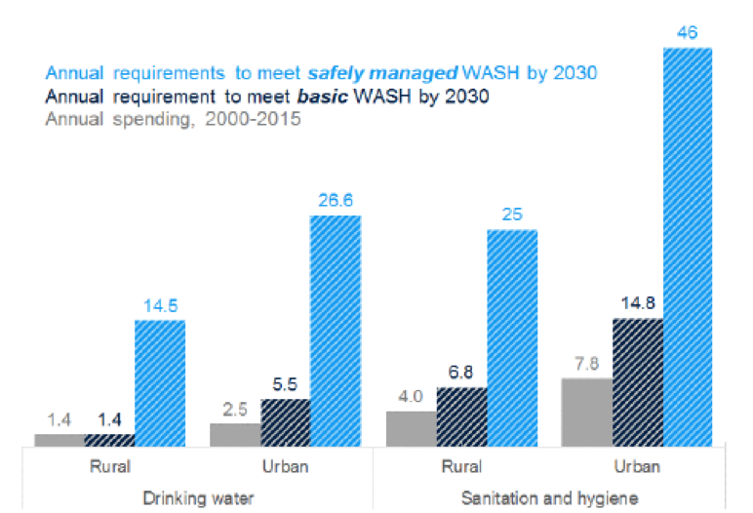
What do SDGs mean for WASH financing in general?
UNICEF Enabling Environment Framework
SDGs carry vastly higher price tag than MDGs
Estimated capital investment to deliver universal access to safely managed WASH: $114 billion per year.
This means that countries will have to increase their investment in the water and sanitation sectors by up to four times
Sanitation = 60% of estimated costs, particularly urban
Need better targeting to reach poorest countries and populations
Source: Hutton & Varughese (2016)

Slide 3
Enabling Environment Framework
UNICEF Enabling Environment Framework

Slide 4
Why invest in WASH in Schools
Access to water and sanitation is a human right – UNICEF’s mandate for children.
Why should governments invest in WASH?
          WASH in schools can lead to the spread of preventable disease and increase
          Reduced school absences, especially among women
          Improve ability to learn better in safe environment
In general the use of public finance is justified:
When the spending provides public goods, or
When the intervention addresses externalities
Water:
Water is essential for life. Access to water should not be left to the market due to risk that water prices will exclude the poor and vulnerable. There is an obligation for governments to intervene.
Sanitation:
Sanitation is a private good that offers public benefits. The use of public finance to support sanitation is justified because it provides benefits for society, not just the individual.

Slide 5
SDG implication in Programming
Steps in strategy development
Core objectives
National WINS policies and strategies
1. Assess need
Greatest deficits in WINS outcomes, sector targets
Gender, Disability, ECD, Nutrition
Effectiveness / Quality:
Fit to need and goal?
package of services appropriate to areas where outcomes need to be improved
2. Sector strategy
For all the sector in Schools
3. Costing
Costs of achieving targets, financing gap
Equity:
Is everyone benefiting?
equity in access (universal) and in funding (contribution according to ability to pay)
4. Funding and financing strategy
Intended flows of funds from
sources
(reconsider strategy if flows insufficient to meet targets)
Our Focus
Efficiency:
Best use of inputs?
Allocative (right distribution) and technical (right approach)
5. Analysis of service use
Uptake, quality and equity

Slide 6
WASH in Schools challenges
UNICEF Enabling Environment Framework
Maintain existing gains
Improve and develop new services

Slide 7
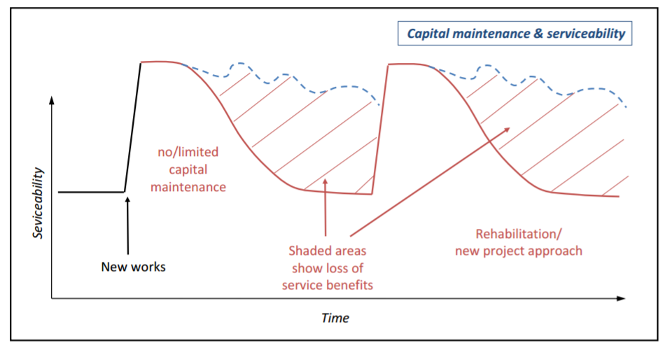
Capital Maintenance challenge
UNICEF Enabling Environment Framework
Is this picture familiar to you?... 10-40% of WASH in School systems broken down;
What does this say about the efficiency and effectiveness of current sector financing?

Slide 8
WASH in School: Life cycle approach
UNICEF Enabling Environment Framework
Capital expenditure – hardware and software (CapEx):
The initial investment in the development of a water or sanitation system, referring to both the investment costs into infrastructure as well as costs related to the mobilization of the community.
Cost of capital:
The rate of return required by the financiers that funded the capital expenditure.
Operating expenditure (OpEx):
Recurrent (regular, ongoing) expenditure on labour (salary for staff), costs for management (transport, fuel), energy and chemicals, materials, and minor repairs of the infrastructure.
Capital maintenance expenditure (CapManEx):
Expenditure on asset renewal, replacement and rehabilitation of the infrastructure.
Expenditure on direct support (ExpDS):
Expenditure on both pre- and post-construction support activities directed to local-level stakeholders, users or user groups
Expenditure on indirect supports: (Exo IDS): Macro level cost, policy development, capacity building, Monitoring
Capital expenditure (CapEx)
Cost of capital (CoC)
Operational expenditure (OpEx)
Capital Maintenance expenditure
Expenditure on direct support
Expenditure on indirect support

Slide 9
Where the WASH in School Financing comes from?
Transfers
Governments/community
Voluntary Contributions
NGO and private sector
WASH Financing (3 Ts)
WASH in School Financing
Taxes
Tariff
School fees, Household contribution
user fees, costs for beneficiaries, community financing, credit, school budget,
parent-teacher association, fees for parents, service charge, and volumetric based water charges.

Slide 10
Why WASH in School Financing is challenging?
Governments/community
Unpredictable, Highly dependent on per student education allocation and utilization may vary, sometimes not regular
NOT PRIORITY
Voluntary Contributions
NGO and private sector
CSR fund
WASH in School Financing
More sustainable sources but not enough to meet the all the WASH in school Costs
School fees, Household contribution

Slide 11
Financial allocation challenges
UNICEF Enabling Environment Framework

Slide 12
Data on few investments case in preparation
Cambodia:
Initial investment: 1.2 billion USD
Recurrent till 2030: 2.2 billion USD
Option to support the WINS investments
Link to new Education school construction programme
Min Education dedicated funding
More advocacy….
Explore financial mechanisms:
  Development impact bond (DIB)
  PPP on WASH in district Wide WINS operation and management
Laos:
Initial investment: 0.9 billion USD
Recurrent till 2030: 1 billion USD
Myanmar:
Initial investment: 1.3 billion USD
Recurrent till 2030: 1.4 billion USD

Slide 13



Need Strong case For Support: leveraging Public finance
UNICEF Enabling Environment Framework
Target Audience
National Gov (MoF, MoP, Min Education of WASH)
Local Government
Parliament
Private Providers
Commercial/ Financial sector
Civil Society Groups
Problem definition
Identified through:
SitAn
CP Objectives
Country Context
Intended Effects
Increase Investment
Improve Investment (efficiency/effectiveness/equity)
Increase transparency/accountability
Fill knowledge gaps
Improve capacity
Enhance coordination
Selection of Tools and instruments
Needs assessment
Costing (SWA)
Cost benefit analysis/Investment Case/Return on investment
Expenditure analysis (TrackFin)
Fund Flow (PETS)
Fiscal space
Political economy analysis
Partner Selection
Government agencies (including MoF/Planning
Ministry of education
Other UN Agencies/IFIs
Development partners
Think tanks/ NGOs/Academics
Civil Society
Modes of Engagement
Technical advice
Analysis /Evidence generation
Advocacy
Capacity Building
Support to partners
Planning stages
Results for
Children

Slide 14
Few examples:
Two presentations:
1- Indonesia Government investment in WASH in schools- : Mr Zulkarnaen Haryo Nugroho, Secretariat of School Health Program at Directorate General Primary and Secondary
2. Nepal Government investing in large scale WASH in schools; Ms Sandhya Chaulagain – Water Aid Nepal

Slide 15
ODF Impact Bonds
Impact
Investor
Step 6. Outcome Funder repays investor principal plus interest, directly or through Financial Intermediary
Step 2. Investor provides upfront capital to Implementer, directly or through Financial Intermediary
Financial Intermediary**
Step 1. Agreement
negotiated between Investor, Implementer,
and Outcome Funder
Outcome Funder
Implementer
Step 5. Independent Evaluator reports results to Outcome Funder
Broker*
Step 3. Implementer implements the programme, with assistance from Technical Advisor
Technical Advisor
Evaluator
Step 4. Independent Evaluator evaluates if results achieved
Population in Need
Notes
*A Broker may facilitate agreements.
**A Financial Intermediary receives the upfront capital from the Investor, distributes the funds to the Implementer, and repays Investors using funds received from the Outcome Funder

