Slide 1
WinS Data and Performance Management in the Philippines
7th WASH in Schools International Learning Exchange
Crowne Plaza Ortigas, Pasig City, Philippines
11 Nov 2019

Slide 2
WASH in Schools three star approach
Notes:
WinS Policy (DO 10 s 2016) is implemented through the 3-star approach whose backbone is data and performance management

Slide 3
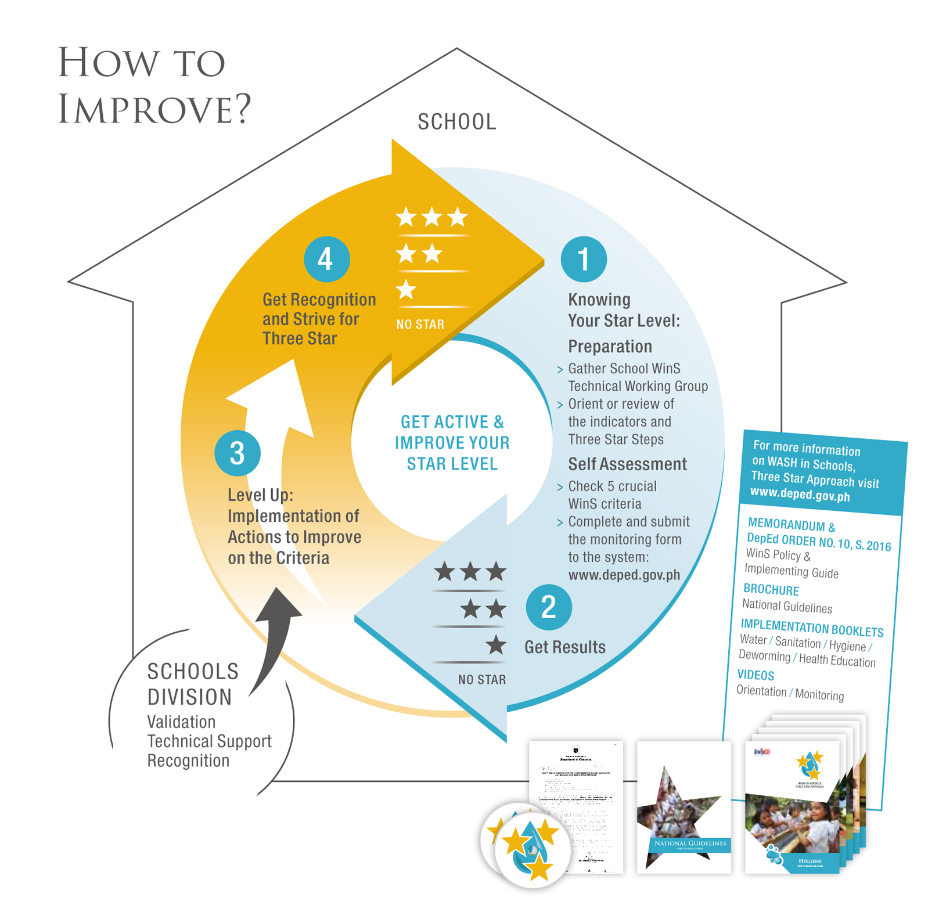

Slide 4
Self-Assessment Checklist & Monitoring
WinS Monitoring Form
Direct Feedback
School Recognition:
Quality Standards:
Encoding and Submission:
Awards based on improvement or meeting of standards
WinS Policy
Three Star Approach
WinS Three Star Rubrics
WinS Monitoring System
Upload in Online System
Analysis and Action:
Validation:
Monitoring reports
Adjustment of School Plan
Implement WinS Program
Ocular visits of selected schools
National Planning & Budgeting
Division Recognition:
Technical Assistance:
Financial & Infrastructure support based on monitoring reports
Awards based on school performance and organizational enablers
Technical Assistance based on monitoring reports
Notes:
The data collected from TSA feeds into several school, division, and national management processs (red boxes)

Slide 5
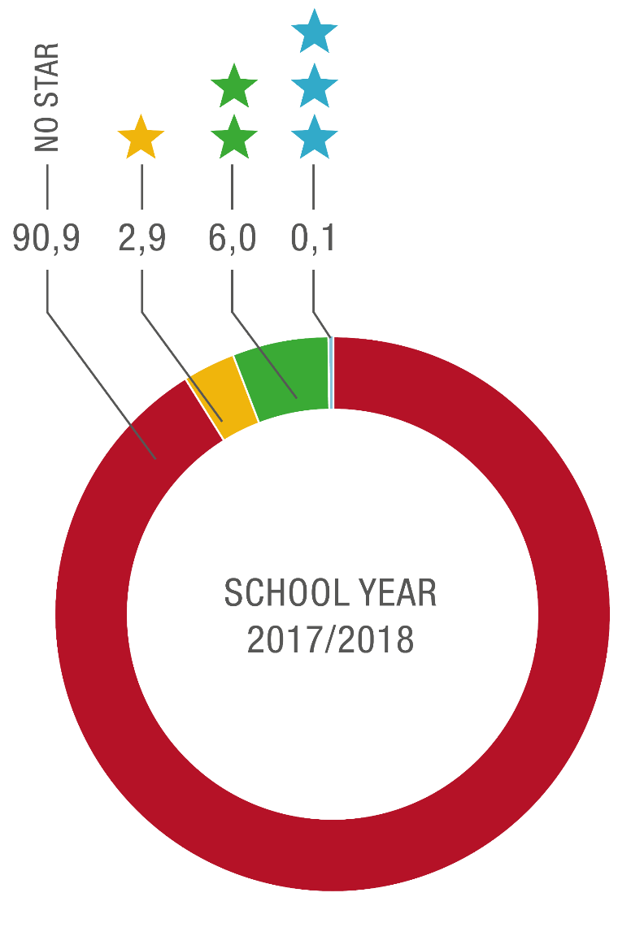
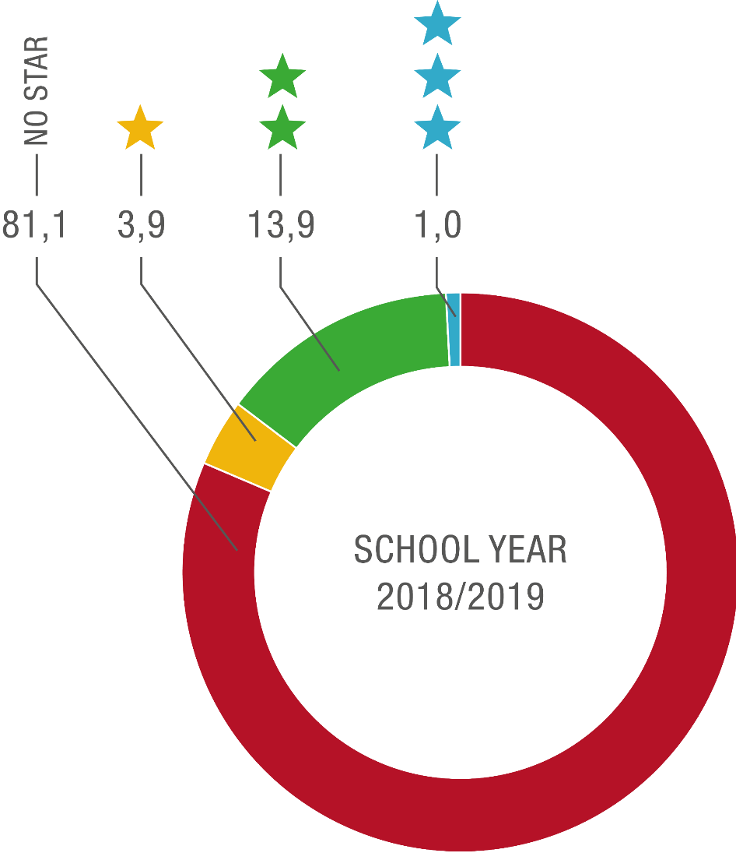
WinS TSA Rating Results
Notes:
Impact of having WinS data: improvement in star rating with 19% reaching at least 1 star, from a baseline of 9% the previous year.

Slide 6
Impacts of Having WinS Data
WinS data as basis and criteria for recognition systems
WinS data was used for budget hearings for fund allocation
WinS data revealed gaps in building design and were addressed accordingly
National reporting & advocacy for WinS (e.g., State of the Nation Address)
Division-level awareness to address WinS and improve the learning environment
Accountability for WinS under School-Based Management

Slide 7
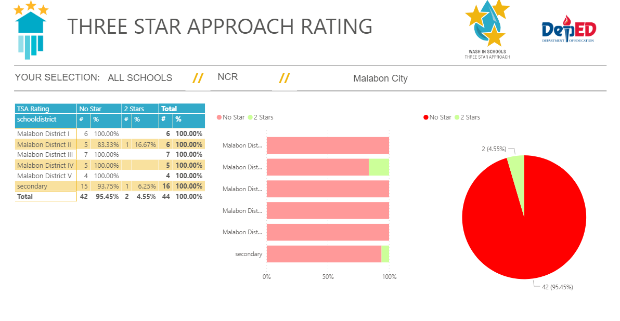
Future Plans
Microsoft Power BI for:
Better data visualization
Dashboard for easy reference
Geographic Information System

Slide 8
Thank you

