Slide 1
Using WinS Data for Resource Mobilization
Mr. Neth Phearum
Chief of Office of Planning and Research
School Health Department,
Ministry of Education, Youth, and Sport
Cambodia

Slide 2
Collecting WinS Data in Cambodia
EMIS: Annual School Census (collected each November)
Since 2018: integration of SDG indicators into Annual Census Form
November 2019 will be 1st time used in annual data collection
Basis for national level reporting and for budget advocacy with MEF
Minimum Requirement Guidelines for WinS (3 Star Approach)
Finalized and endorsed by Minister November 2016
Pilot data collection in some provinces in 2017 and 2018
1st nationwide Baseline data collection November 2018
MR Questionnaire as an attachment to the Annual Census Form

Slide 3
Use of WinS data in Cambodia
Use for Target Setting
Use School Census data to identify baseline and formulate targets for toilets, drinking water and handwashing facilities in ESP 2019-2023
Use MR data identify baseline and formulate targets for WASH Minimum Requirements star levels in ESP 2019-2023
and Resource Mobilization through advocacy
MEF allocated additional budget to meet infrastructure needs to reach the targets: EMIS data to show how many schools were missing essential infrastructure (toilets and water access)
External Funds: Improvements in MR Star levels are linked to EU Budget Support, School Health Department responsible for Baseline and tracking progress - MoEYS advocates with MEF to allocate this budget for school health

Slide 4
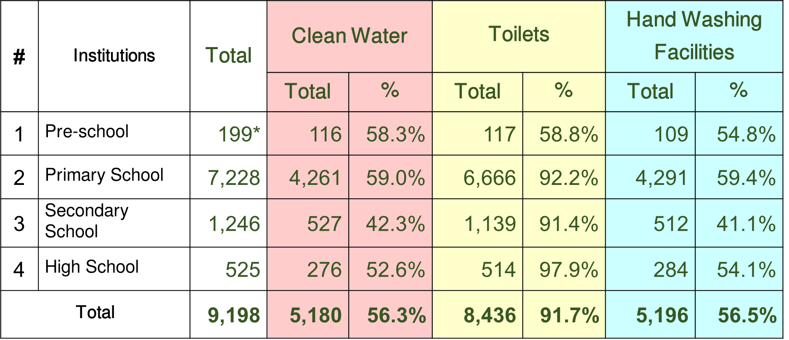
Example: Using School Census data to calculate number of schools without access to Drinking Water, Toilets and Handwashing Facilities

Slide 5
Example ESP 2019-2023: WinS Indicators for the Primary Subsector
No. | Indicators | Units | 2018 | 2019 | 2020 | 2021 | 2022 | 2023
1 | Percentage of Primary Schools with toilets | % | 90.6 | 91.5 | 92.4 | 93.2 | 94.1 | 95.0
2 | Percentage of Primary Schools with clean water | % | 59.3 | 60.2 | 61.2 | 62.1 | 63.1 | 64.0
3 | Percentage of Primary Schools with handwashing facilities | % | 56.7 | 58.4 | 60.0 | 61.7 | 63.3 | 65.0
5 | Percentage of Primary Schools with WASH Minimum Standard
Star 1 |  | % | 45.3 | 47.1 | 48.9 | 50.6 | 52.4 | 54.2
Star 2 |  | % | 22.4 | 22.7 | 23.0 | 23.4 | 23.7 | 24.0
Star 3 |  | % | 1.4 | 1.5 | 1.6 | 1.6 | 1.7 | 1.8
Total |  |  | 69.1 | 72.7 | 75.2 | 76.8 | 77.8 | 80.0

Slide 6
What challenges did you encounter?
Challenges | Countermeasures
Self-assessment: how to verify? | Spot-checks, Capacity Development for School Principals, SBM Training, …
How to feedback data to schools? | Development of Report Cards, Certificate of Appreciation, …
Limited capacity for data analysis | Close cooperation with EMIS department, Support from Development Partners, …
Future steps: how to handle two similar but separate data sets?

Slide 7
Plans and Vision for WinS Data
November 2019: First time use of Annual School Census with SDG aligned WinS indicators
November 2019: Second round of data collection on Minimum Requirements
Continuation in current set-up (attachment to School Census) until end of ESP period
Create real-time database for more comprehensive School Health Data collection

Slide 8
Thank you for your attention!

