Slide 1
FSM WinS Data and Performance Management Good Practices and Challenges
DEANNA AIZAWA
CHIEF - Planning, Development and Research Division
Chuuk State Department of Education
PRESSLER MARTIN
CHIEF - Curriculum and Instruction
Pohnpei State Department of Education

Slide 2
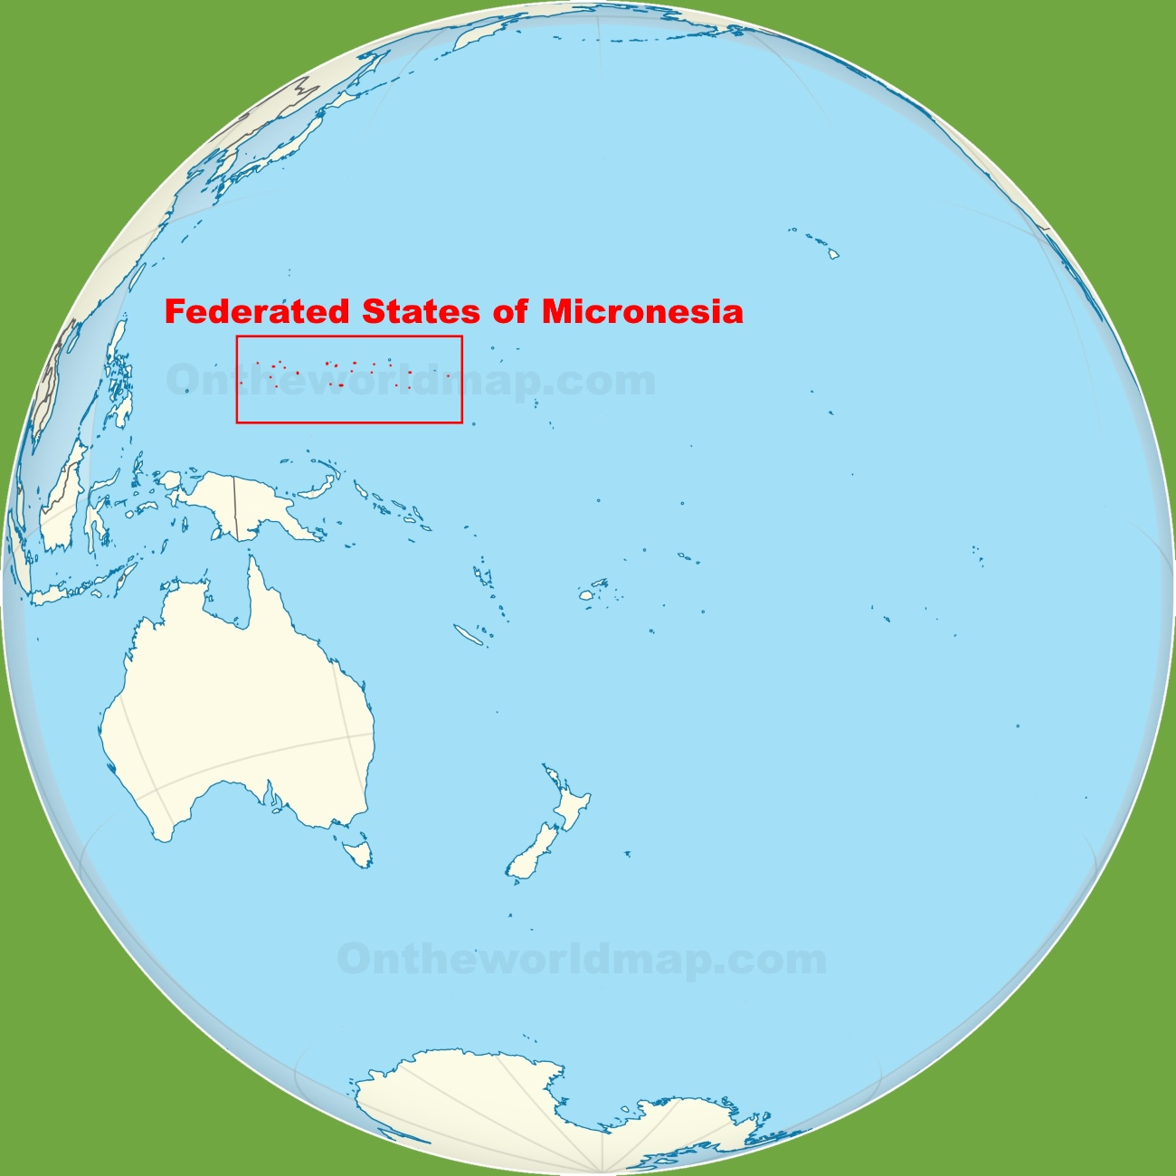
Federated States of Micronesia
4
States
607
Islands
185 Schools
26,015 schoolchildren

Slide 3
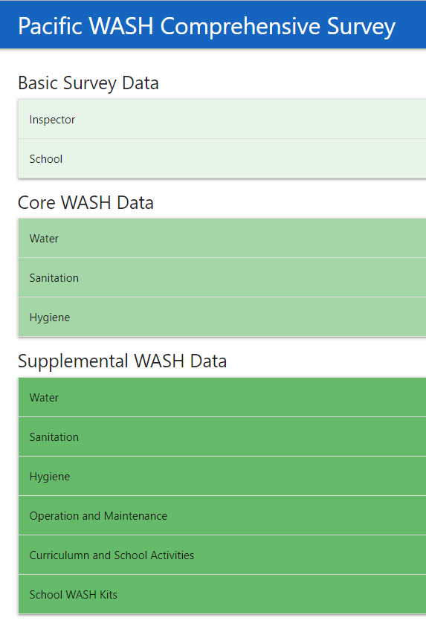
FedEMIS
a platform that caters basic data requirements at the national and state Department of Education
it digitized most of the historical data that were available in different formats and at the different State departments
2
WASH indicators
Comprehensive WASH Survey
TRANSPARENCY
PLANNING
RESOURCE ALLOCATION
ACCREDITATION

Slide 4
School’s Accreditation System
Six (6) School Assessment Standards:
1. Leadership Standard
2. Teacher Performance Standard
3. Data Management Standard
4. National Curriculum Standards, Benchmarks and Student learning Outcomes Standard
5. School Campus, Classrooms and Facilities Standard
6. School Improvement Planning
Three-Star Approach
Valid certification from Environmental and Protection Agency/ Environmental Health and Sanitation
ACCREDITATION
TRANSPARENCY
PLANNING
RESOURCE ALLOCATION

Slide 5
Challenges and Way Forward
Partnership with government agencies needs improvement
Strengthen inter-sectoral collaboration
Lack of WinS Policy
Facilitate issuance of the national WinS policy
Lack of comprehensive WASH data
Roll-out of WinS in FedEMIS
Unclear guidelines on WASH in Schools
Incorporation of the contextualized Three-Star Approach in the School’s Accreditation System
Lack of WASH concepts in the curriculum
Revisit and refine the existing health curriculum

