Slide 1

Capacity Development Initiatives for Wins
MA. GEMMA M. LEDESMA, CESO V
Regional Director
DepEd Regional Office VI

Slide 2
Country Context
Organizational Arrangement:
At DepEd Central Office level, WinS is with the Bureau of Learner Support Services (School Health Division) as one of the flagship programs under the OK sa DepEd (Health Operational Plan)
As contextualized at the Regional Level, WinS in Region VI is lodged at the Field Technical Assistance Division (FTAD)
WinS is an agenda for technical assistance to schools.
School-Based Management (SBM) serves as the mechanism for the implementation.
Potential target audience of capacity development initiatives:
  Number of Regional Officials - 30 (RFTAT Members)
  Number of Division Officials - 340 (SDS, ASDS, PSDS)
  Number of School Heads - 4,068 (School Heads)

Slide 3
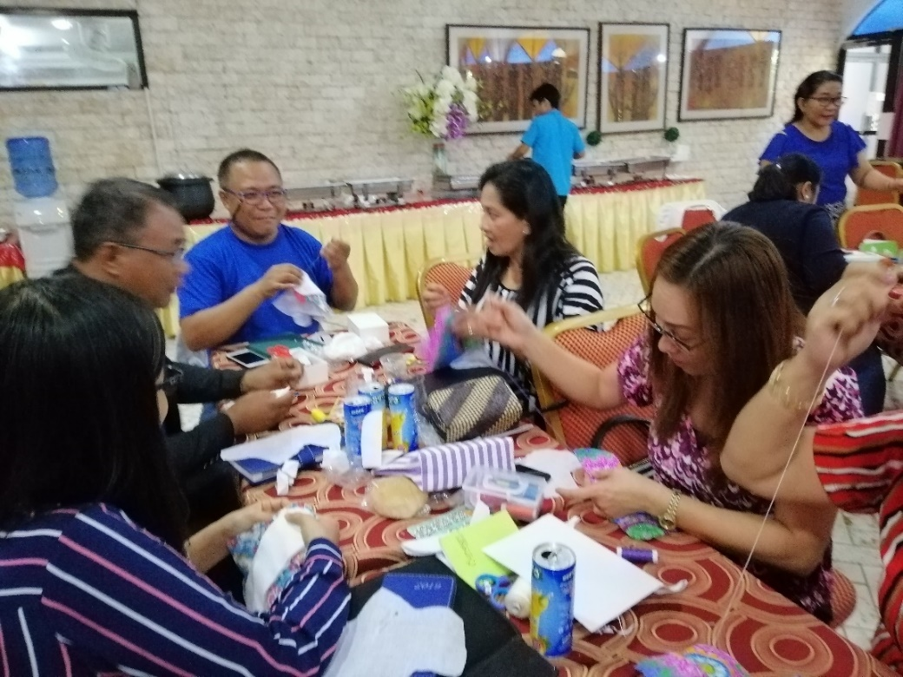
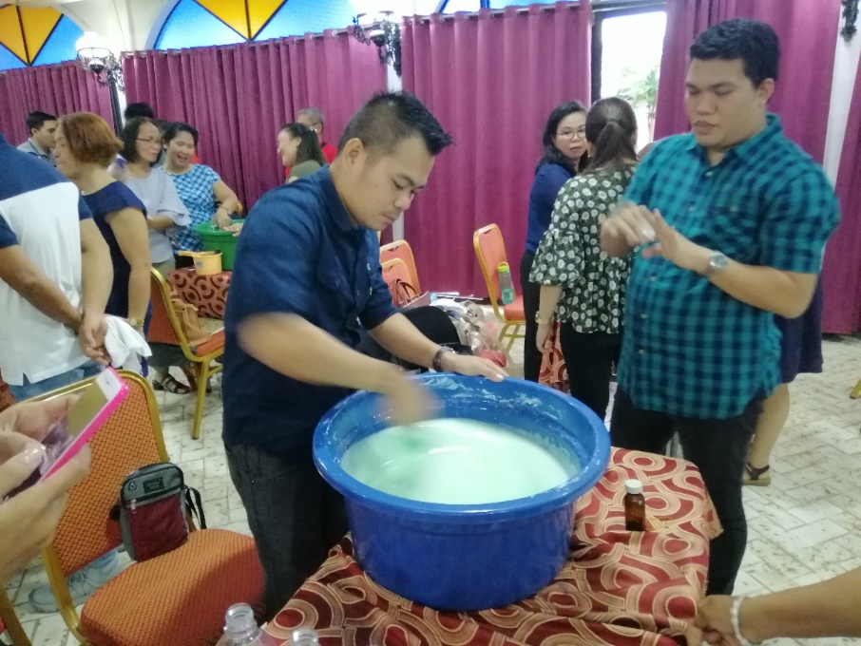

Capacity Development on WinS
Approaches on capacity development on WinS:
Training-Workshops and capacity-building activities funded through Regional Maintenance & Other Operating Expenses (MOOE).
Notes:
Priority Improvement Areas (PIA) are identified through WinS Program Implementation review (PIR).
If the Capacity-Building needs are common to all SDOs or majority experiences certain challenges in WinS implementation (example, sustainability of hygiene kits and supplies – Liquid soap making, Pasador making, low cost water treatment, etc.)

Slide 4
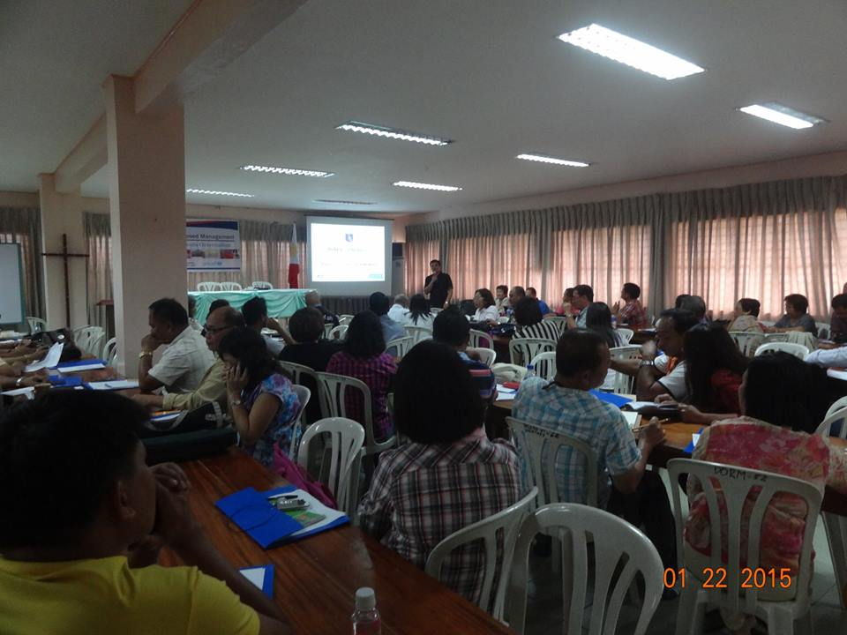
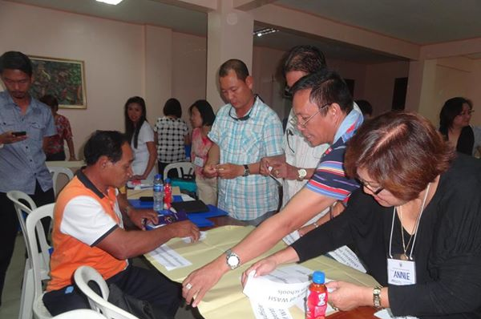
Capacity Development on WinS
Approaches on capacity development on WinS:
2. Topic for discussion during ManCom, In-Service Trainings, Parents-Teachers Meetings, Card Day and other conferences.
Notes:
- WinS as one of the agenda in the ManCom, school and division in-service trainings during semestral breaks, Card days, PTA Meetings, etc.
- WinS topics (using the Region-crafted Learning Resource Packages) are integrated in school activities such as Science/YES-O Camp, Boy/Girl scouting activities, Nutrition Month celebration, etc.

Slide 5
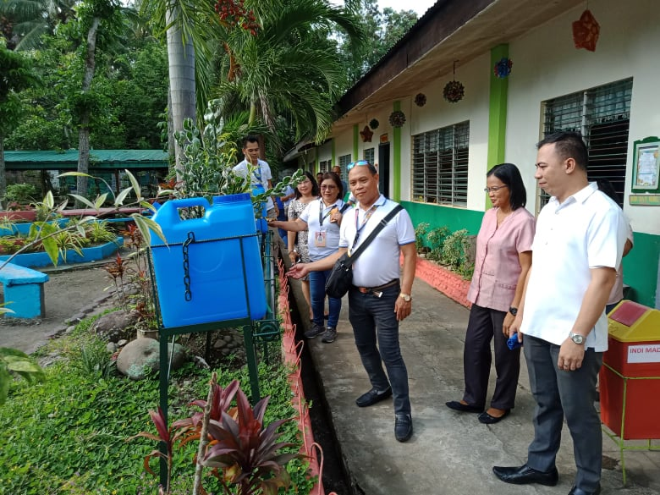
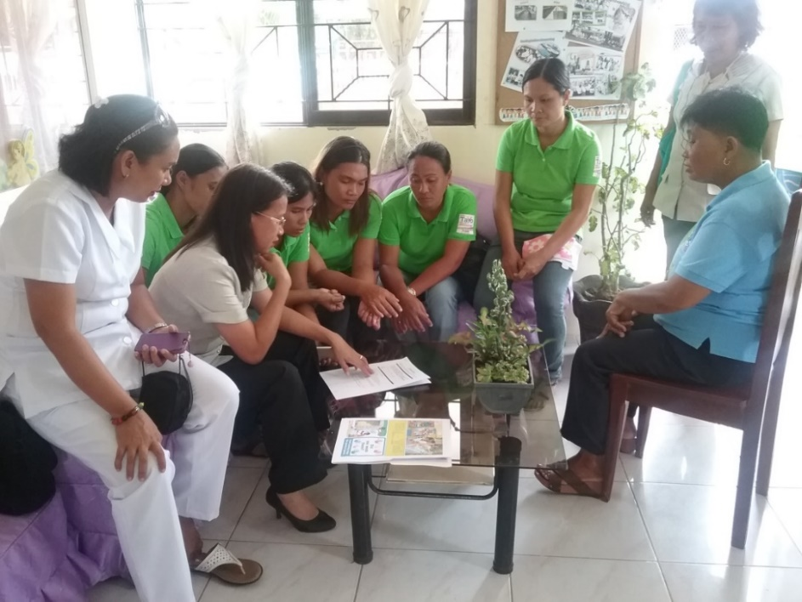
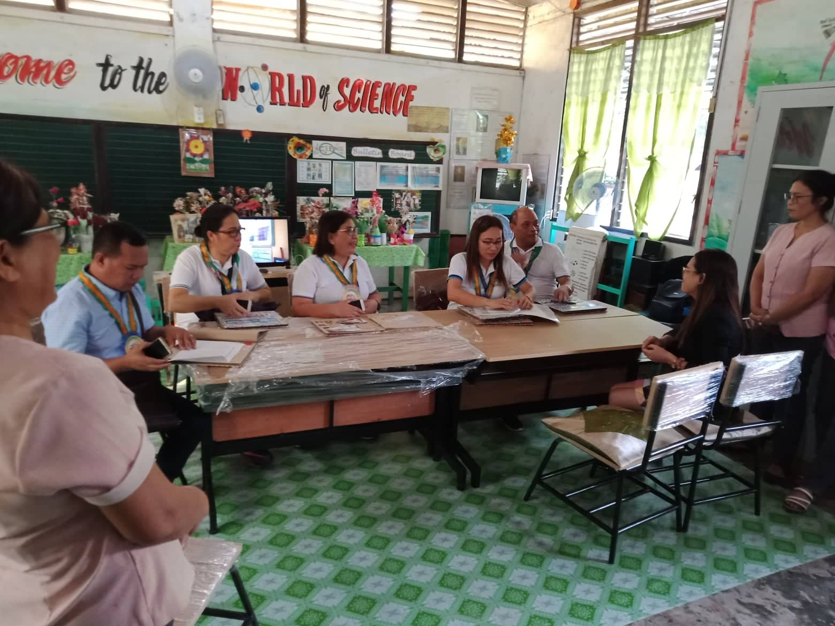
Capacity Development on WinS
Approaches on capacity development on WinS:
3. Provision of Technical Assistance through the Regional Field Technical Assistance Teams (RFTATs).
Notes:
- To ensure implementation of the first two initiatives, M&E and TA are coursed through the Regional and Division Field Technical Assistance Teams (RFTATs / DFTATs).
- Utilizing the results of the WinS 3-Star Approach Tool, RMEA and M&E technical assistance targets are set during coordination meetings, Technical Assistance on WinS are provided by RFTATs through coaching and mentoring schools and SDOs
- SDOs craft Technical Assistance Plans, Regional FTAD consolidates TA needs identified and requested by Schools Division Offices (SDOs).

Slide 6
Capacity Development on WinS
Effect/ consequences of the CD approach:
(from 3-Star Approach Online Monitoring System - OMS)
Elementary |  |  |  |  | Secondary
YEAR | 0Star | 1Star | 2Stars | 3Stars | 0Star | 1Star | 2Stars | 3Stars
2016 | 91.82% | 2.35% | 5.83% | 0% | 98.67% | 0% | 1.33% | 0%
2017 | 73.88% | 5.02% | 20.28% | 0.82% | 83.28% | 1.79% | 13.43% | 1.49%
2018 | 47.33% | 6.20% | 39.42% | 7.05% | 42.84% | 3.88% | 42.69% | 10.60%
Number of Schools in Region VI | Elementary | 3,402
 | Secondary | 670
 | Total | 4,072
Notes:
With these strategies, specific indicators and priority improvement areas are addressed, making sure that needed technical assistance reach the schools.
Thus, resulting to improved Star rating

Slide 7

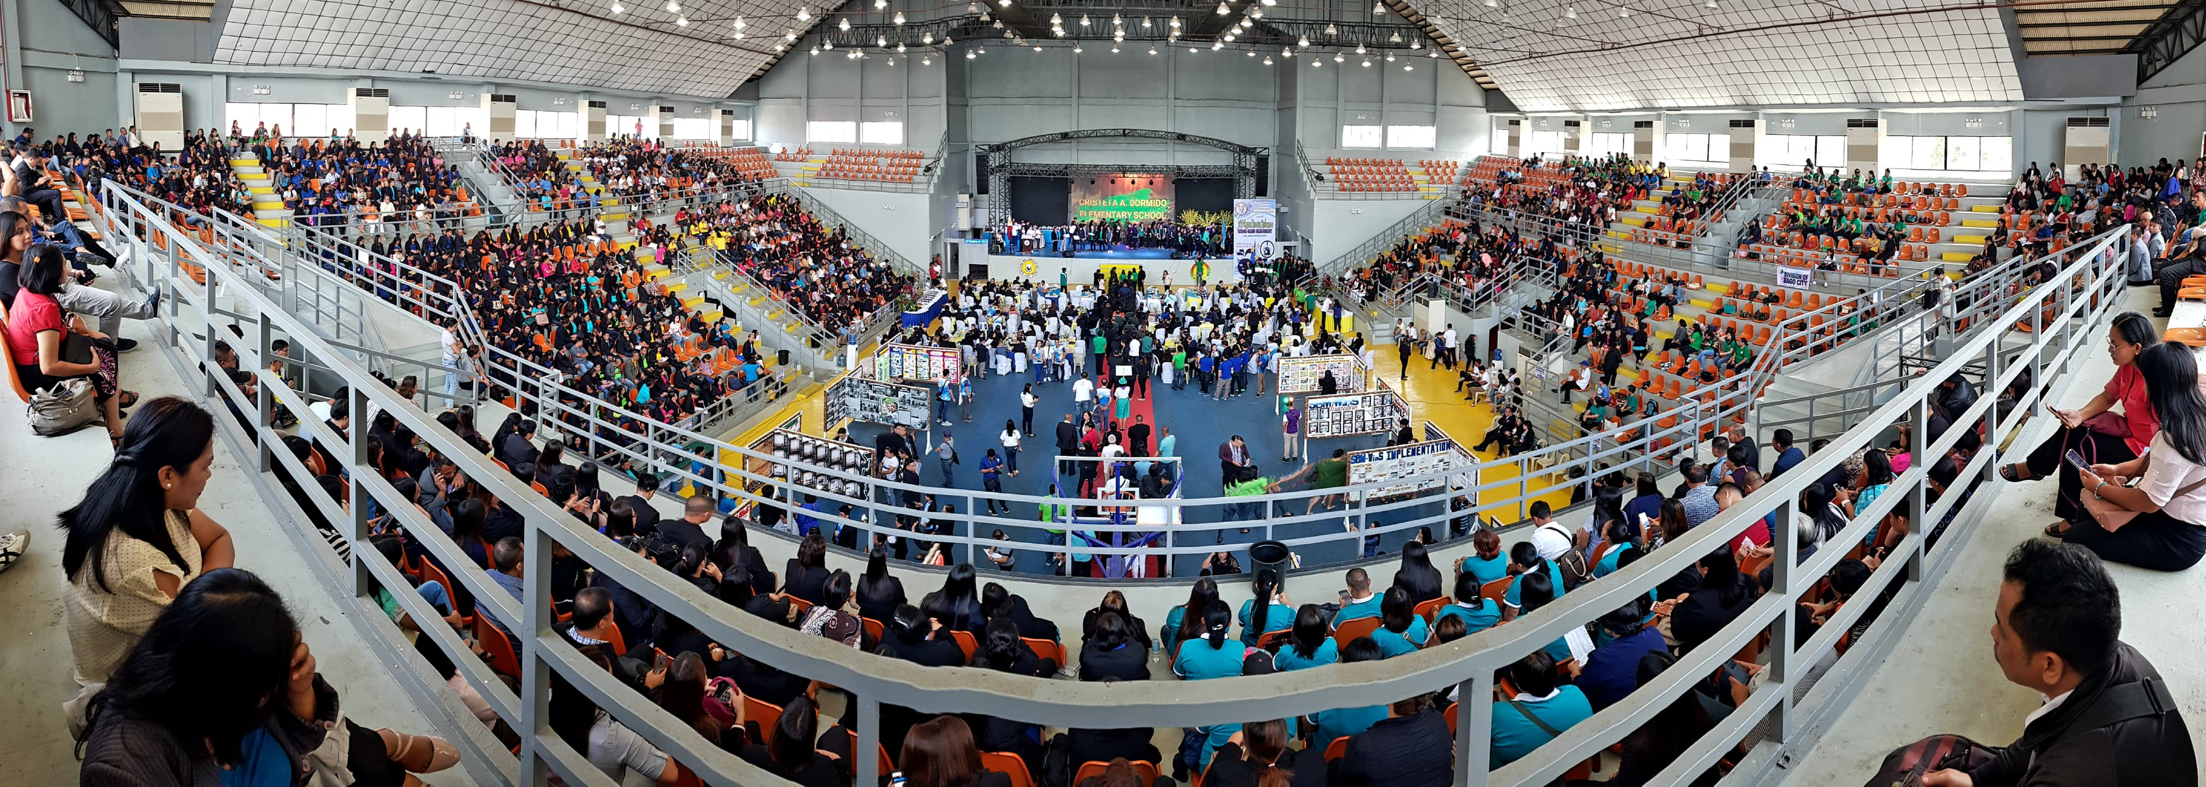
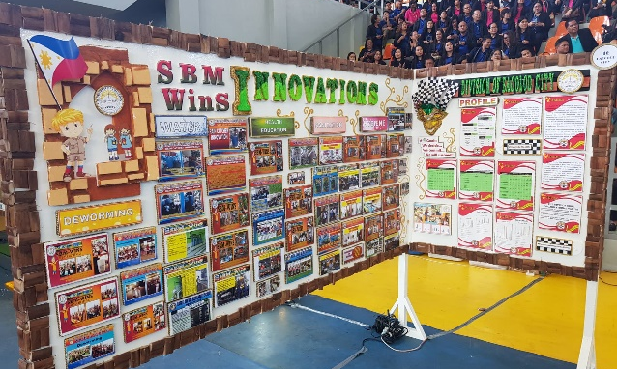
4. SBM-WinS Learning Exchange
(Regional / Division / District)
Celebration of efforts and achievements, at the same time capacitating schools and schools divisions through benchmarking.
Notes:
Conduct of Regional/Division/District SBM-WinS Learning Exchange
As a way of celebrating the efforts and achievements by schools and schools divisions, SBM-WinS Learning Exchanges are conducted in different governance levels – which at the same time capacitates schools and schools divisions through benchmarking.

Slide 8
Learnings:
School-Based Management – effective mechanism to implement WinS
Three-Star Approach is an effective tool to formulate specific interventions for specific challenges
Rewards and incentives really motivate schools and divisions to do better
WinS Champion Leaders – the key factor

Slide 9



Challenges and Future Perspectives:
Challenges:
Geographical locations of schools
Unavailability of water sources
Funds for trainings
Future perspectives:
Region VI experiences shaped the development of a Massive Open Online Course (MOOC) on WinS

Slide 10



Thank you...
Happy WinSday!
Notes:
Thank You…
Happy WinSday everyone… in Region VI, Everyday is a Winsday.

