Slide 1
School Health Coordinators & WASH caretakers Capacity Building
Deki Tshering
Senior Programme Officer, WASH
School Health & Nutrition Division, Department of School Education
Ministry of Education, Bhutan

Slide 2
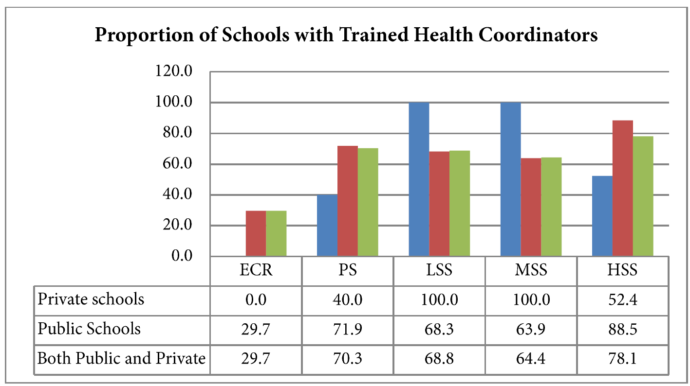
Capacity Development on WinS
School Health Coordinator’s and WASH caretakers training are key component for WinS programme to improve the overall health of the child in schools.
Health Coordinators are trained on: safe use of toilets, handwashing with soap and water, safe use of drinking water, waste management, personal hygiene, food hygiene, MHM, First Aid and Mgt of minor aliments, eye & ear care, vaccination, drugs and non-drugs and influenza.
WASH caretakers are trained to properly operate and maintain the WASH systems and services in schools
Data source: EMIS 2019 Data source: EMIS 2019

Slide 3
Learnings and Challenges
Learnings:
83% of the teachers assert that handwashing program is successful in schools, KAP Study on handwashing among school children in Bhutan 2018.
World Water day and Global Handwashing days are instituted in schools across the country.
68% of schools have both soap and water in their toilets, KAP Study on handwashing among school children in Bhutan 2018.
Engagement of parents/community in terms sustaining WASH practices for all in future.
Challenges: transfer of trained school health coordinators, resigning of trained WASH caretakers, limited WASH O&M fund, limited fund for capacity building from government
Future perspective: All schools to have at least one trained school health coordinator and WASH caretakers, fund for WASH O&M, access local government fund for capacity building

