Slide 1

WinS Capacity Development in Lao PDR
Dr. Soutsakhone Chanthaphone
Director of the Centre for Environmental Health and Water Supply
Ministry of Health

Slide 2
Capacity Development on WinS
Orientation follows a cascade-model:
  Orientation on WinS implementation approach for 18 Provincial Officers by national level;
  Orientation for District Officers by Provincial Offices;
  District Officers include in regular meetings with their schools
Follow-up through peer-to-peer Learning Exchanges
  from school to school through cluster system
  From district to district to reflect on good practices and solutions to common problems (and create a basis for comparison)
  From province to province (including visits to schools at different implementation stages)

Slide 3
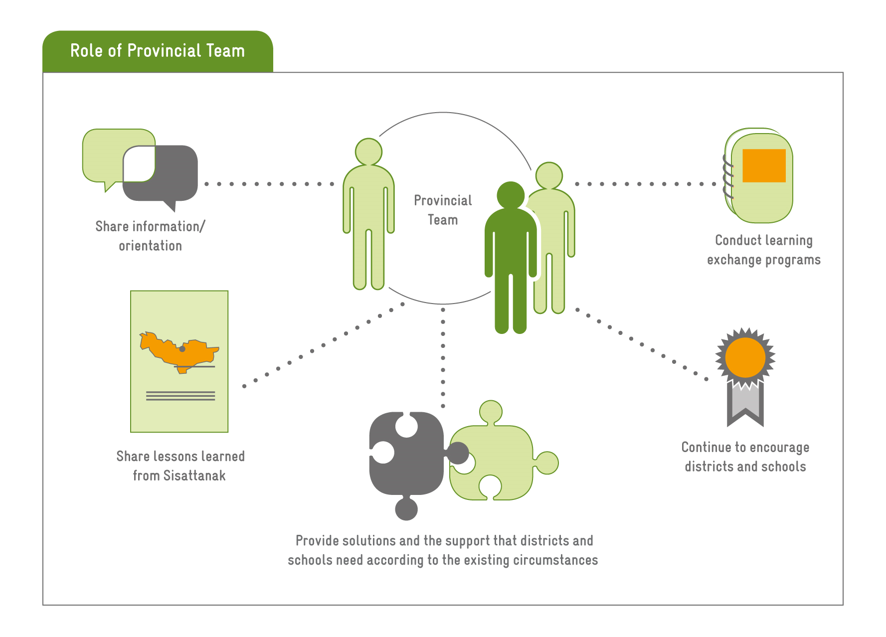

Slide 4
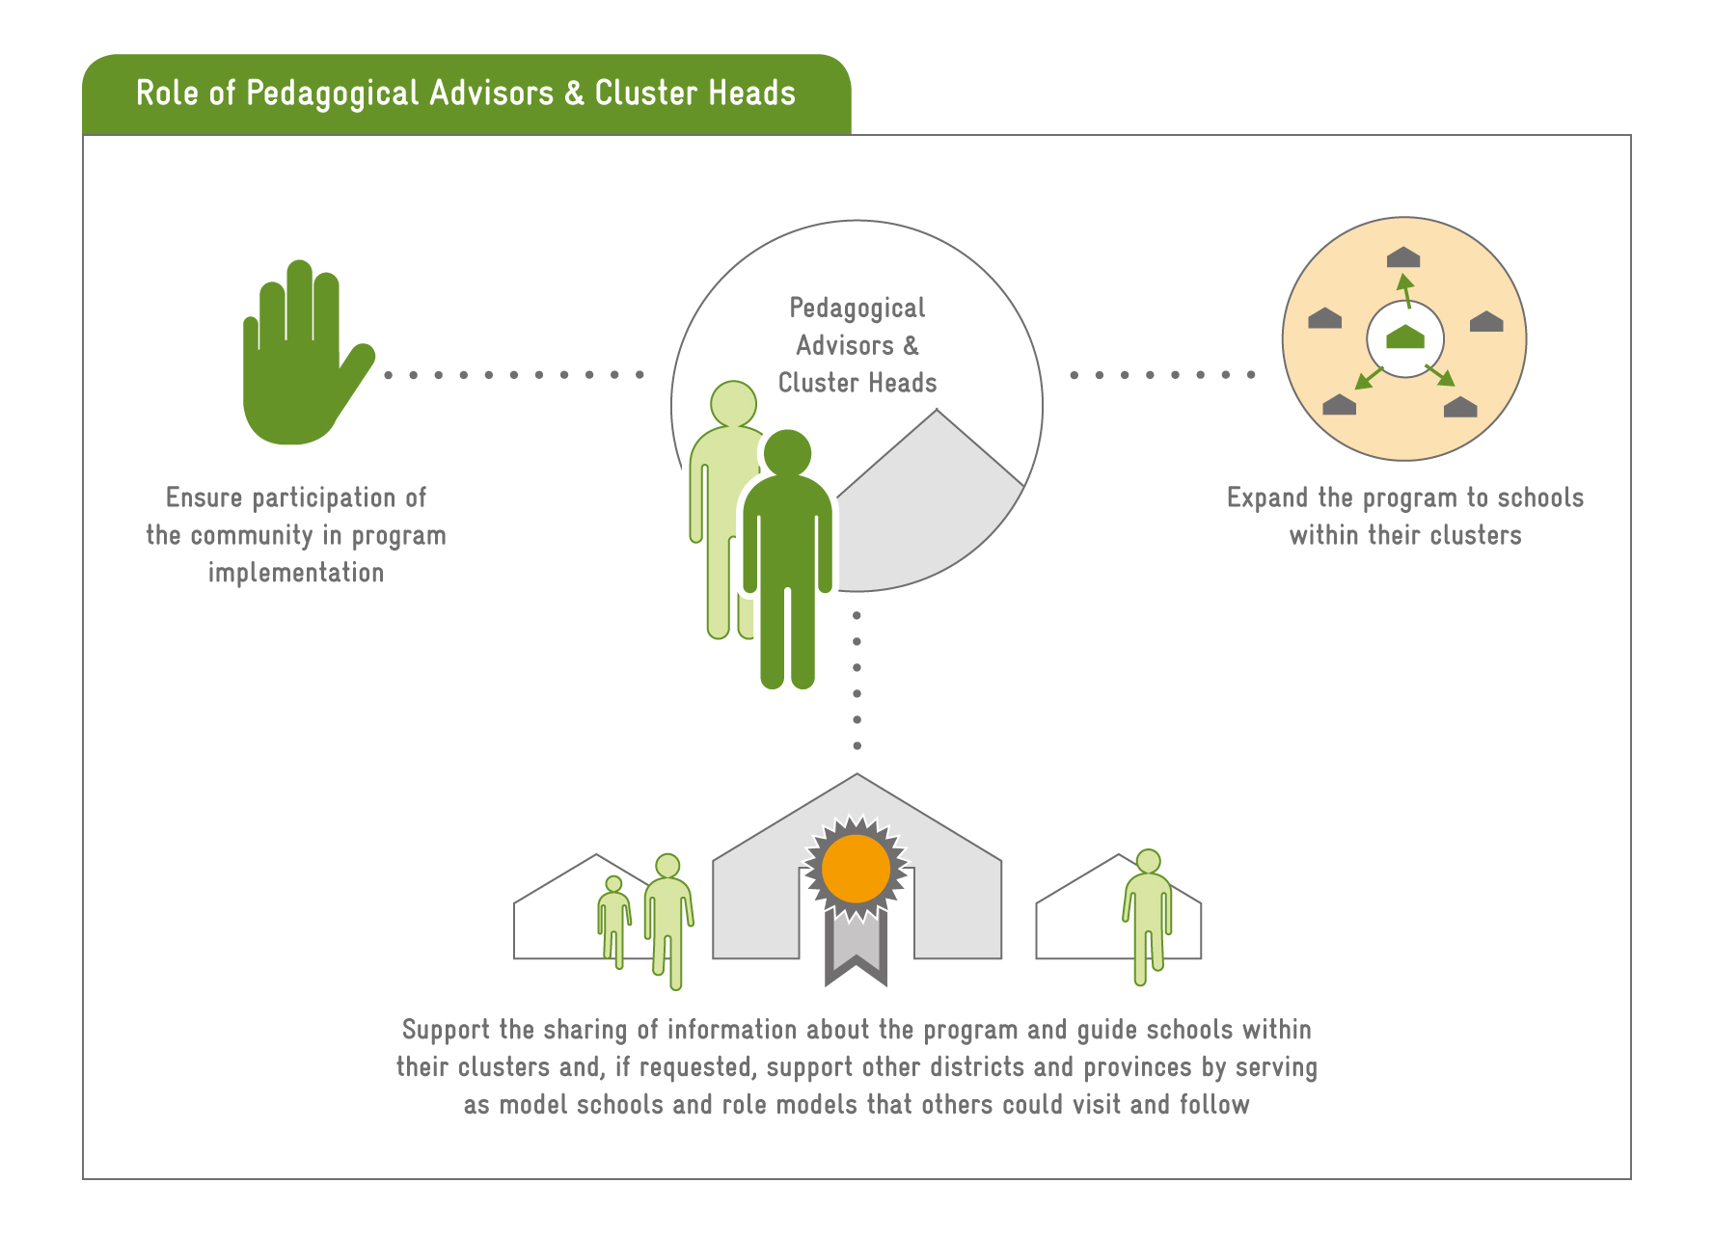

Slide 5
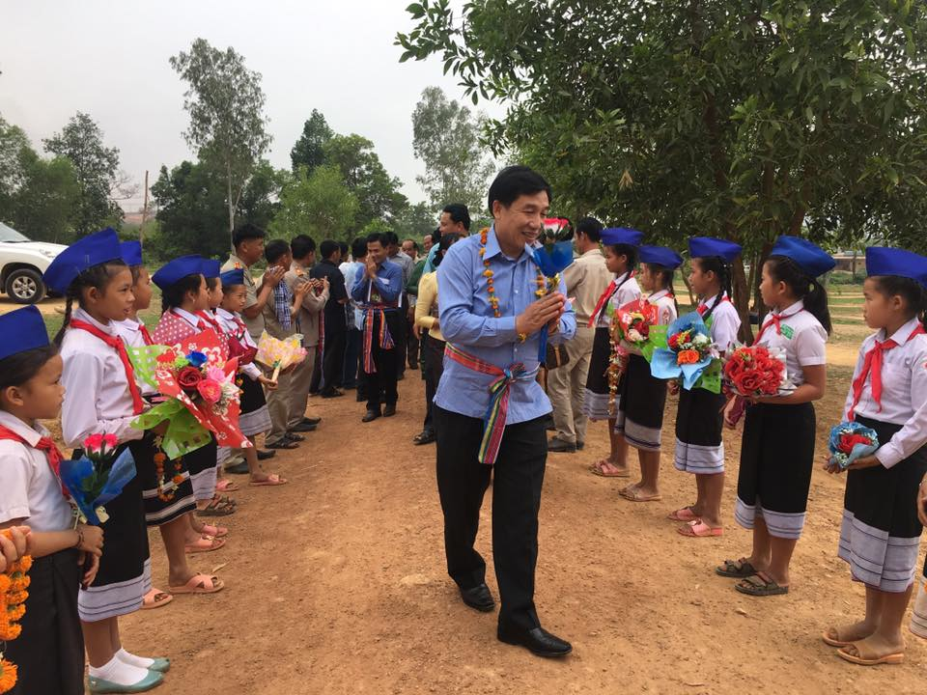
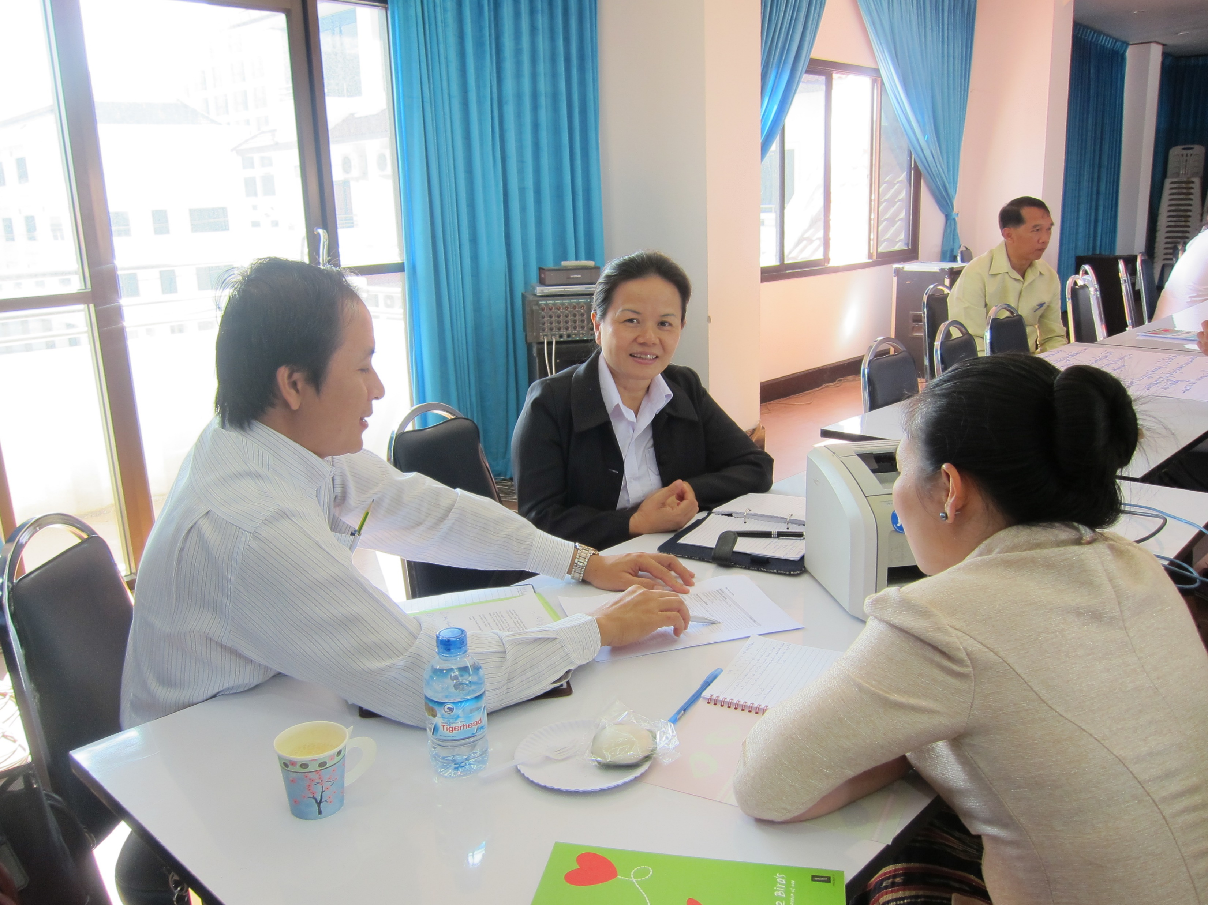
Capacity Development on WinS
Use of low-cost learning materials (videos, manuals) – videos have proven to be helpful tool to convey the same message by different facilitators
Encouraging districts/ provinces to start with 1 model and expand from there on the basis of experience and learning exchanges
Approach allows flexibility on district level: they scale up in their own speed –many districts decided to scale up to all schools and managed the process through exchanges within the clusters quickly!

Slide 6
Key Learnings
Use of existing meetings and structures helped for dissemination and transfer of knowledge
Learning exchanges helped sharing knowledge and supported practical learning by schools and provincial/district officers
School clusters became the knowledge hub for sharing implementation experiences and encouraging all schools in the respective cluster
Pedagogical Advisors and Cluster Heads need to have good technical knowledge, communication and mentoring skills

Slide 7
Challenges and Future Perspective
Challenges:
  Motivate and encourage provincial and district officials to advocate for WinS and orient schools
  Motivate and encourage schools to implement Wins (establishment of recognition structure)
  Raise awareness on all levels for sustainability of implementation
Future perspective:
  Continue regular exchange experience internal and external
  Further emphasize WASH in existing meeting and curriculum

