Slide 1
Wash in School
Experience from Bangladesh

Slide 2
Education System of Bangladesh
Primary Education system covers Pre-Primary to Grade V covering almost 18 million children through 65,593 Primary Schools.
Secondary and Higher Education system covers Grade VI to XII.
Two separate ministries involve for two systems, one for Primary Education and other for Secondary and Higher Secondary Education

Slide 3
Policy and strategies and their role in WinS
Polices | Linkage with WinS
National Education Policy 2010 | Acknowledges need of separate WASH facilities for girls and boys including Children with Disabilities at schools.
National Hygiene Promotion Strategy for Water Supply and Sanitation Sector in Bangladesh, 2012 | Acknowledge importance of WinS
Bangladesh National Hygiene Survey - Baseline in 2014 and follow up in 2018 | States comprehensive status of WinS
National Standards of Water, Sanitation and Hygiene for Schools in Bangladesh, 2012. | Provides clear guidance on WinS
Sector Development Plan (SDP) for WASH | Includes WinS with importance
7th five year plan | Includes WinS with importance
Notes:
Circular by Ministry of Education on 23rd June 2015;
Circular on January 27, 2019 to address SDG,
School feeding program.

Slide 4
Upcoming Policies
Presently working on upcoming policy for MHM strategies where MHM at school level will be addressed.
UNICEF-GoB three star approach for WinS;
Developing operation and maintenance guideline for WinS under PEDP4 supported by UNICEF Bangladesh.
Policy for Water Supply and Sanitation will be updated which will include WinS focusing SDG.

Slide 5
Achievement
All the schools have provision of safe drinking water
Need based gender segregated 28,500 Wash Blocks have been constructed in 14,000 Government Primary Schools;
GO-NGO collaboration boosted up sanitation and hygiene practice in schools;
Training on Schools Hygiene covered 14,000 Government primary Schools supported by WSUP.
Government support for routine maintenance for Wash Blocks continued.

Slide 6
Primary Education Development Programme -4 and WinS
Component
Sub-Component
WinS Linkages with Sub-components
1. Quality
1.1. Curriculum
1.2. Textbook, teaching & learning materials
1.4. Teacher education
Hygiene education , MHM and climate change issues are being incorporated in Curriculum, Text books, and teachers Education modules.
2.3. Maintenance
2.4. Water and sanitary hygiene
2.6. Special education needs and disability
2.7. Education in emergencies
2.8. Communications & social mob.
Adequate budgets are allocated.
Policy and WASH standards are approved
Infrastructure of WASH Facilities and need based and disability friendly
EiE interventions put highest priority in WASH in school.
WinS got priority in SocMob
2: Access & Participation
3: Management, governance
3.3 Strengthened Decentralized Education Planning
(SLIP & UPEP)
Sub-district and Primary School Planning deliberately kept budgetary provision for WinS.

Slide 7
Target for PEDP-4
Sub-component | Activities
Water, Sanitation and Hygiene | Construction of 58,000 WASH blocks for 29,000 primary schools (one for girls & female teachers and one for boys & male teachers). Installation of 15,000 water sources for Schools.
Maintenance of WASH Facilities | Major repairs of WASH block 10,000; Minor repairs of WASH block 28,500.

Slide 8
WinS progress measurement indicators in PEDP-3
WinS indicator | Target | Achievement | Source
Percentage of schools with at least one functioning toilet | 95% | 89% | Annual Primary School Census ‘2018
Percentage of schools with separate functioning toilets for girls | 95% | 66% | Annual Primary School Census’2018
Percentage of schools that have safe water sources: functioning tube wells and other source | 95% | 97% | Annual Primary School Census’2018

Slide 9
How PEPD-4 envisions WinS Result
WASH in PEDP-4 | Description of Result
Result | Schools have adequate WASH facilities for teachers and students
Components | Schools have gender segregated and disability friendly WASH blocks meeting national standards. Schools have group hand washing facilities. Schools are managing solid waste. SMC, teachers and students are aware of good hygiene practices. Teachers and SMC capable of maintaining school WASH facilities. Hygiene practices in all schools ensured. Education officers aware of Three Star Approach. Menstrual Hygiene management facilities is ensured.

Slide 10
Implementation Arrangements
Ministry of Primary and Mass Education is the executing agency responsible for overall policies, guidance, coordination and oversight.
Directorate of Primary Education is the main implementing agency.
All Field Level Offices and Institutions under DPE involve in implementation of PEDP4 activities.
DPHE is the main implementing partner agency for development activities of Water, Sanitation and Hygiene in Government Primary Schools.

Slide 11
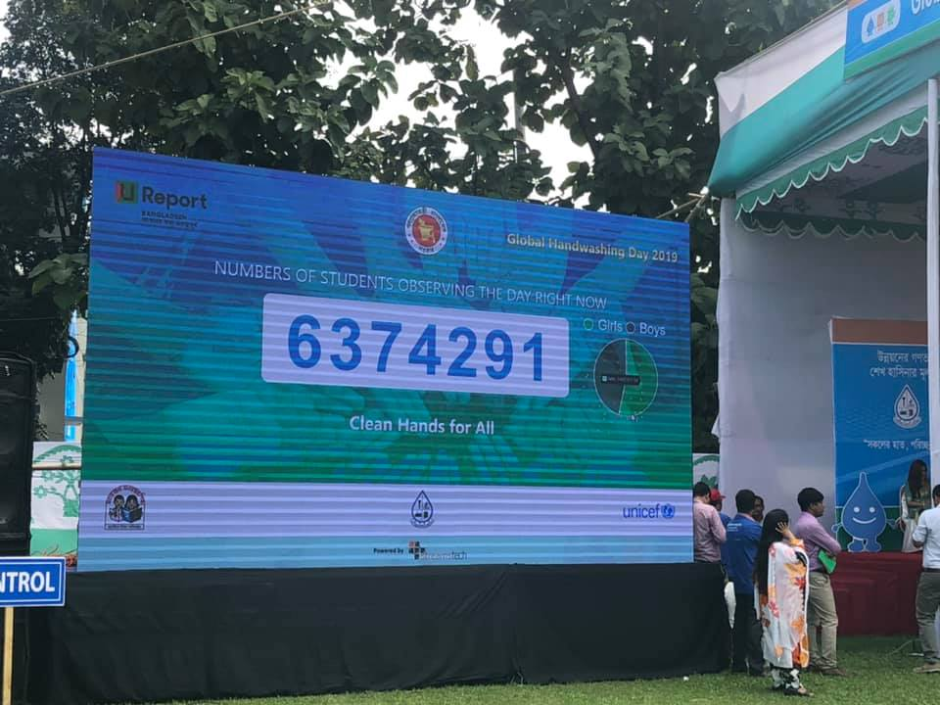
Celebration of GHD 2019
Around 7.5 million students from 59,631 Government Primary schools washed hands with soap and water at a time.
The numbers were collected through real time reporting, displayed during central programme and declared by LGRD&C State Minister.

Slide 12
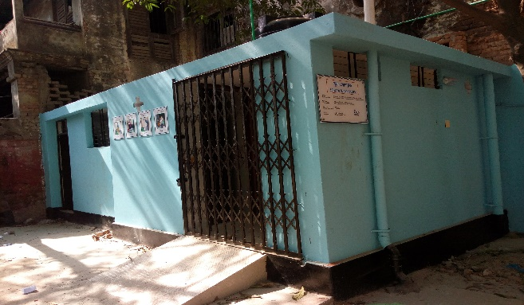
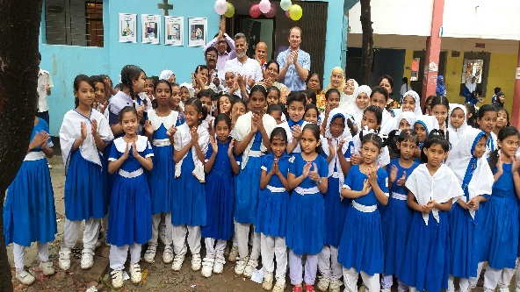
WASH Block in Primary schools

Slide 13
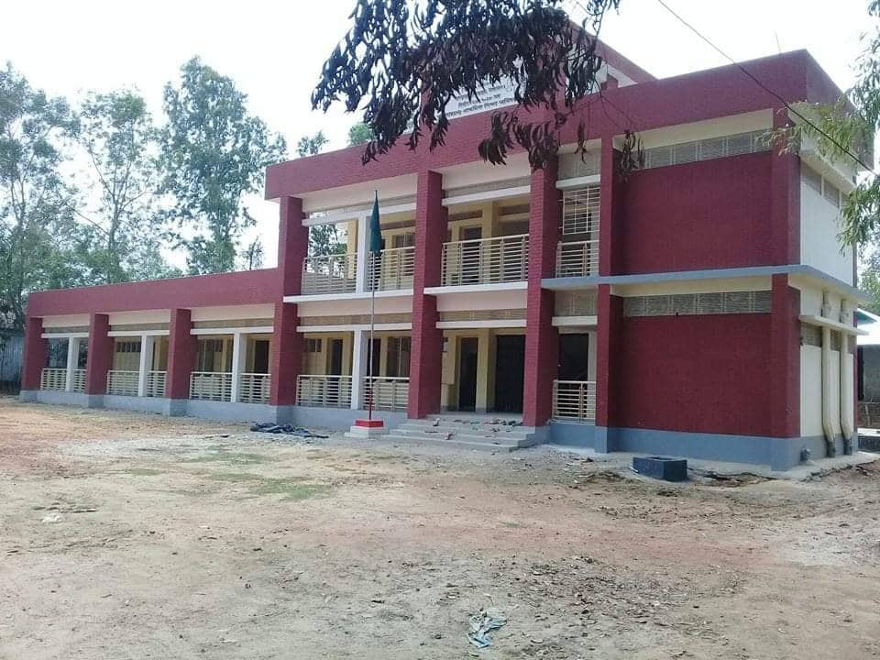
Considerations while installing WASH BLOCK 1. WASH Block must be constructed attached to school building. 3.Two storied WB where ground is for Male Teachers and boys while first floor is for Female teachers and girls. 4. RCC frame structure instead of Brick structure.

Slide 14
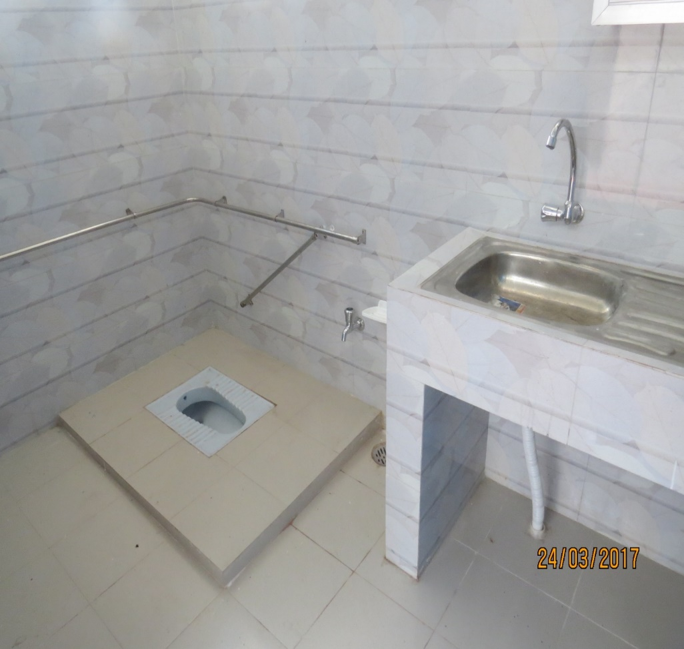
Toilet for students

Slide 15
Toilet for Girls

Slide 16
Addressing MHM

Slide 17
Challenges
Education System in Bangladesh is large. School going children are huge in number. So, whatever initiative is taken, faster momentum difficult to achieve.
Though government primary schools are covered by different development projects, but non government schools get nominal financial support from the government, as such these schools lag behind.
Capacity enhancement and effective management are crucial for its smooth and proper implementation.
Quality control of infrastructure Development.

Slide 18
Challenges
Proper Monitoring for construction of quality infrastructure/repair & maintenance of school & other offices of DPE.
Coordination with implementing agency and all line division of DPE
Fund for Routine Maintenance is not sufficient for keeping the School premises and Wash Blocks neat and clean.
Having the policies available at grass root level and operationalize
Continuous Operation and Maintenance of WASH facilities

Slide 19
Way Forward
Review the National Standards of Water, Sanitation and Hygiene for Schools in Bangladesh, 2012 focusing on SDG
Policy for Water Supply and Sanitation needs to be updated including WinS focusing SDG.
Finalizing operation and maintenance guideline for WinS under PEDP4 supported by UNICEF Bangladesh.
Disseminate operation and maintenance guideline for WinS to all schools, and
Plan and arrange capacity building program for the Head Teachers and SMC Chair Person on operation and maintenance guideline for WinS.

Slide 20
Thank you

