Slide 1
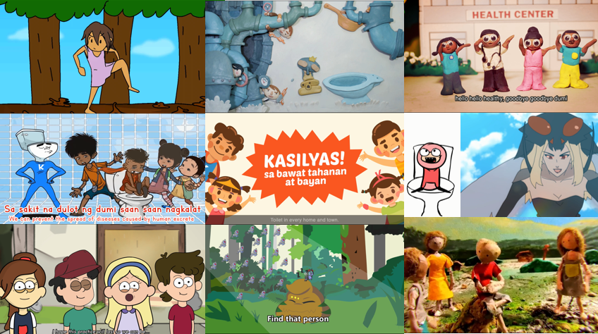
Share your favorite
Goodbye, Dumi! Hello, Healthy! animation contest entry on Facebook!
http://bit.ly/goodbyedumi

