Slide 1
Focus on Accelerated WinS Progress
Proposal for A consensus/Outcome document
7th International Learning Exchange for WASH in Schools
Manila | 11-15 November 2019
Habib Benzian
Research Professor
Associate Director Global Health & Policy | WHO Collaborating Centre
Epidemiology & Health Promotion | College of Dentistry & College Global Public Health
New York University | New York
habib.benzian@nyu.edu

Slide 2
Do we need a consensus document?
How could such a document be helpful?
How would you use the document in your work?
What might be key content elements?
Company or Presentation Name
Presentation / Section Name

Slide 3
Purpose of an Consensus document
Company or Presentation Name
Presentation / Section Name
Public acknowledgement of major international developments or advancing knowledge
Highlighting implications for WASH in Schools
Suggesting focus areas to improve coverage and service quality
Advocacy & expression of commitment to action
UNICEF/GIZ internal use - supporting programming, internal planning & resource mobilisation
Continuation of a history / working culture of previous ILEs

Slide 4
Recognition of Important international developments
Company or Presentation Name
Presentation / Section Name
JMP Report on WASH in Schools (2018)
Process of national WinS monitoring alignment with SDG framework
Recognition of successes - need to increase universal action and resource allocation
Deeper knowledge related to key sector challenges and options to address them

Slide 5
Company or Presentation Name
Presentation / Section Name
Example:
6th ILE Myanmar Outcome Document (2017)

Slide 6
Company or Presentation Name
Presentation / Section Name
Example:
5th ILE Jakarta Outcome Document (2016)

Slide 7
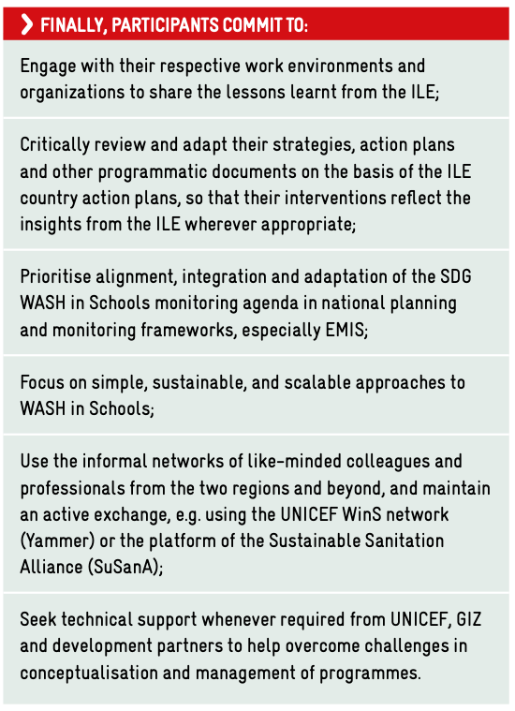
Acknowledgment of WinS Call to Action (2011) Focus action areas Commitment by participants - not countries Executive summary of technical event content

Slide 8
Education sector ownership & leadership
2. National WinS Standards aligned with SDGs
3. Monitoring & evaluation
4. Increased budget allocation
Suggested Priority action Areas

Slide 9
Process proposal
THank you - questions?
Company or Presentation Name
Presentation / Section Name
Zero Draft is in your conference package
Everyone can comment using the feedback form - feedback per table
Small drafting/reference committee to be appointed
Document will not be a report of the meeting but rather an expression of CDO commitment
Discussion of key challenges -
Further refinement and fine-tuning during session on Thursday
Final version on Friday in closing session

