Slide 1


Regional Overview:
Country Action plans and Progress on WinS Enabling Environment
Evariste Kouassi Komlan
Regional Adviser, WASH
UNICEF EAPRO

Slide 2
Session Objective
Regional Overview of Progress on 6th ILE
Country Action Plan Updates
WinS Action Plan
Country : xxxxx
Policy and Planning
Budget and Expenditures
Monitoring & Evaluation:
……
…….
……….
………………………..
………………….
………………….
………………
……………….
Implementation Arrangements
…………………………
……………………..
Capacity Development:
…………………..
…………………..
Critical Challenges (Bottlenecks) remain in the WinS Enabling Environment to further strengthen WinS in respective countries

Slide 3
Evolution of ILE on WinS
2012 Philippines
Introduction to Bottleneck Analysis
2013 New Delhi
Use of MoRES Determinants for Country Action Planning
2014 Vientiane
Use of Bottleneck Analysis with additional guidance
2015 Sri Lanka
Identified WinS Enabling Environment Enablers
2016 Jakarta
Focus on WinS EE Enablers
2019 Manila
Traffic Light Monitoring on WinS EE Enablers
2017 Nay Pyi Taw Traffic Light monitoring in WinS EE

Slide 4

What did we commit in 2017 ILE?
Strengthening WinS Monitoring & SDG and EMIS
WinS implementation at Scale and Three Star Approach: Operation and Maintenance
Menstrual hygiene management & Gender
WinS as a human right for all children
Improved WinS implementation quality

Slide 5




How did we progress?
Overall, very good progress has been observed in policy and planning EE building block in most countries;
Significant progress has been noted in the monitoring and evaluation domain with many countries reporting good EMIS;
Good Progress has also been made in capacity development with hygiene education integrated in national curriculum in most countries;
Implementation arrangements is constrained in most countries with a lack of essential commodities for WinS ;
Budget and expenditure continues to be the most constrained in many countries;

Slide 6
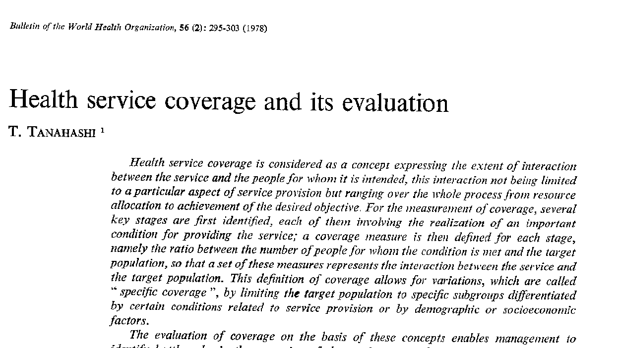
Why Enabling Environment for Wins?
IMPACT
Financing Envelope
Service Coverage
Service Quality
Target Population
Client Behaviours
Inequalities in coverage
Quality coverage

Slide 7
WinS Enabling Environment Building Blocks
WinS Enabling Environment Key Enablers
Policy & Planning
Budget & Expenditure
Monitoring & Evaluation
Implementation Arrangements
Capacity Development
Policy and Planning
Is there a national policy on WinS?
Budget & Expenditure
Is there a public sector budget line for WinS?
Capacity Development
Are there clear national targets for WinS?
Are there clear roles and responsibilities for WinS?
Is gender addressed in the national WinS policy?
Is accessibility addressed in the national WinS policy?
Monitoring & Evaluation
Implementation Arrangements
Is WinS data reflected in the national Education Information System?
Are actors sufficiently guided on how to manage and implement WinS in their respective units?
Are essential WinS commodities readily available?
Is there a national WinS monitoring system that supports program management on all levels?
Is there a system for acknowledging WinS performance?
Is there adequate budget to support WinS improvement, operation, and maintenance?
Are schools in most need of WASH support given priority as reflected in expenditures?
Does the Ministry of Education have a plan or strategy for Human Capacity Development for WinS?
Is skills-based hygiene education/promotion included in the national curriculum and part of daily school life?
Is WinS included as part of education management training?

Slide 8
Basis of the Analysis
Major assessment areas:
  Five EE building blocks
  16 indicators
  19 Country Action Plans

Slide 9
Regional Progress Overview on WinS EE BB
5 countries met the target
2 countries met the target
2 countries met the target
1 Country met the target
1 Country met the target
Sector Policy
&
Strategy
Budget
&
Expenditure
Monitoring
&
Evaluation
Implementation Arrangements
Capacity Development
4= Complete | 3= Good Progress/On-track, | 2= Constrained | 1= No Progress

Slide 10
Regional Progress Scorecard on WinS EE
WinS Key Enablers and Indicators |  | Cambodia |  |  | China |  |  | DPRK |  | Fiji |  |  | Indonesia |  |  | Lao PDR |  |  | Myanmar |  |  | PNG |  |  | Philippines |  |  | Timor Leste |  |  | Vanuatu |  |  | Vietnam | Afghanistan |  | Bangladesh |  |  | Bhutan |  |  | India |  |  | Nepal |  |  | Pakistan |  |  | Sri Lanka
 |  | ### | ### | ### | ### | ### | ### | ### | ### | ### | ### | ### | ### | ### | ### | ### | ### | ### | ### | ### | ### | ### | ### | ### | ### | ### | ### | ### | ### | ### | ### | ### | ### | ### | ### | ### | ### | ### | ### | ### | ### | ### | ### | ### | ### | ### | ### | ### | ### | ### | ### | ### | ### | ###
Policy & Planning | Is there a national policy on WinS? | 2 | 2 | 4 | 3 | 3 | 3 | 3 | 2 | 2 | 3 | 3 | 2 | 3 | 3 | 2 | 2 | 3 | 2 | 3 | 3 | 2 | 3 | 4 | 3 | 4 | 4 | 4 | 4 | 4 | 2 | 1 | 2 | 2 | 1 | 1 | 2 | 3 | 3 | 2 | 3 | 3 | 3 | 3 | 3 | 3 | 3 | 3 | 2 | 3 | 4 | 2 | 2 | 2
 | Are there clear national targets for WinS? | 2 | 2 | 4 | 2 | 3 | 3 | 2 | 2 | 1 | 3 | 3 | 1 | 2 | 3 | 2 | 2 | 2 | 2 | 3 | 4 | 3 | 4 | 4 | 3 | 4 | 4 | 3 | 3 | 3 | 2 | 2 | 2 | 3 | 2 | 1 | 2 | 2 | 2 | 1 | 3 | 3 | 3 | 3 | 3 | 2 | 3 | 4 | 2 | 2 | 4 | 2 | 3 | 3
 | Are there clear roles and responsibilities for WinS? | 3 | 3 | 3 | 3 | 3 | 3 | 2 | 2 | 2 | 3 | 3 | 2 | 2 | 3 | 3 | 3 | 3 | 2 | 3 | 3 | 2 | 3 | 4 | 3 | 4 | 4 | 2 | 2 | 2 | 3 | 1 | 3 | 3 | 3 | 3 | 2 | 2 | 2 | 2 | 2 | 3 | 2 | 2 | 2 | 2 | 3 | 4 | 2 | 3 | 4 | 2 | 3 | 3
 | Is gender addressed in the national WinS policy? | 3 | 3 | 3 | 3 | 3 | 3 | 3 | 2 | 2 | 2 | 3 | 2 | 2 | 2 | 2 | 2 | 3 | 2 | 2 | 3 | 2 | 3 | 3 | 3 | 4 | 4 | 3 | 3 | 3 | 3 | 1 | 2 | 3 | 2 | 1 | 1 | 3 | 3 | 2 | 3 | 3 | 2 | 3 | 3 | 3 | 3 | 4 | 2 | 3 | 4 | 2 | 3 | 3
 | Is accessibility addressed in the national WinS policy? | 2 | 2 | 3 | 3 | 3 | 3 | 1 | 2 | 2 | 2 | 3 | 1 | 1 | 2 | 2 | 2 | 3 | 2 | 2 | 2 | 2 | 3 | 3 | 3 | 4 | 4 | 3 | 3 | 3 | 2 | 1 | 2 | 2 | 1 | 1 | 2 | 3 | 3 | 2 | 3 | 3 | 2 | 2 | 3 | 3 | 3 | 4 | 2 | 3 | 3 | 2 | 2 | 2
Budget & Expenditure | Is there a public sector budget line for WinS? | 2 | 2 | 3 | 2 | 2 | 3 | 2 | 2 | 2 | 2 | 4 | 2 | 2 | 3 | 2 | 2 | 2 | 2 | 2 | 2 | 1 | 2 | 3 | 3 | 3 | 4 | 2 | 2 | 2 | 2 | 2 | 2 | 2 | 1 | 1 | 1 | 3 | 3 | 2 | 2 | 2 | 3 | 2 | 3 | 3 | 3 | 2 | 2 | 2 | 3 | 2 | 2 | 2
 | Is there adequate budget to support WinS improvement, operation, and maintenance? | 1 | 1 | 2 | 3 | 3 | 3 | 2 | 2 | 3 | 3 | 3 | 2 | 2 | 2 | 1 | 1 | 2 | 1 | 2 | 2 |  | 2 | 2 | 2 | 3 | 3 | 3 | 3 | 3 | 1 | 1 | 1 | 2 | 1 | 1 | 2 | 2 | 3 | 2 | 2 | 2 | 2 | 2 | 2 | 2 | 2 | 2 | 2 | 2 | 3 | 2 | 2 | 2
 | Are schools in most need of WASH support given priority as reflected in expenditures? | 2 | 2 | 3 | 3 | 3 | 3 | 2 | 2 | 1 | 3 | 3 | 1 | 1 | 2 | 2 | 2 | 2 | 2 | 2 | 2 | 2 | 2 | 2 | 3 | 3 | 3 | 3 | 3 | 3 | 2 | 1 | 1 | 2 | 2 | 1 | 2 | 2 | 2 | 3 | 3 | 3 | 2 | 3 | 3 | 3 | 3 | 2 | 2 | 2 | 3 | 2 | 2 | 2
Monitoring & Evaluation | Is WinS data reflected in the national Education Information System? | 2 | 3 | 3 | 3 | 2 | 2 | 2 | 2 | 2 | 3 | 4 | 3 | 3 | 3 | 2 | 2 | 2 | 2 | 3 | 3 | 3 | 4 | 4 | 3 | 4 | 4 | 2 | 2 | 2 | 2 | 2 | 2 | 2 | 1 | 2 | 2 | 3 | 3 | 3 | 3 | 3 | 3 | 3 | 3 | 2 | 2 | 2 | 2 | 2 | 3 | 2 | 2 | 2
 | Is there a national WinS monitoring system that supports program management on all levels? | 2 | 2 | 2 | 2 | 2 | 2 | 2 | 2 | 1 | 2 | 3 | 2 | 2 | 2 | 1 | 2 | 2 | 2 | 2 | 2 | 1 | 2 | 2 | 3 | 4 | 4 | 1 | 1 | 1 | 1 | 1 | 2 | 2 | 3 | 3 | 2 | 3 | 3 | 2 | 2 | 2 | 2 | 2 | 2 | 1 | 2 | 1 | 2 | 2 | 3 | 2 | 4 | 4
 | Is there a system for acknowledging WinS performance? | 2 | 2 | 2 | 3 | 3 | 2 | 1 | 2 | 2 | 3 | 3 | 1 | 1 | 1 | 1 | 2 | 2 | 2 | 2 | 2 | 1 | 2 | 1 | 3 | 4 | 4 | 2 | 2 | 2 | 2 | 1 | 2 | 3 | 1 | 1 | 2 | 2 | 2 | 2 | 3 | 3 | 2 | 3 | 3 | 1 | 2 | 4 | 2 | 2 | 3 | 2 | 2 | 2
Implementation Arrangements | Are actors sufficiently guided on how to manage and implement WinS in their respective units? | 2 | 2 | 3 | 2 | 3 | 2 | 2 | 2 | 1 | 3 | 3 | 2 | 2 | 3 | 2 | 2 | 2 | 1 | 2 | 2 | 2 | 2 | 3 | 2 | 4 | 4 | 2 | 2 | 2 | 2 | 1 | 2 | 3 | 2 | 2 | 2 | 2 | 3 | 3 | 2 | 2 | 2 | 2 | 2 | 2 | 2 | 2 | 2 | 3 | 3 | 2 | 2 | 2
 | Are essential WinS commodities readily available? | 3 | 3 | 2 | 3 | 3 | 3 | 2 | 2 | 2 | 2 | 3 | 2 | 2 | 3 | 2 | 2 | 2 | 2 | 2 | 2 | 1 | 1 | 1 | 3 | 3 | 3 | 3 | 3 | 3 | 3 | 2 | 3 | 3 | 1 | 1 | 2 | 3 | 3 | 2 | 2 | 3 | 2 | 2 | 2 | 2 | 2 | 1 | 2 | 2 | 3 | 2 | 2 | 2
Capacity Development | Does the Ministry of Education have a plan or strategy for Human Capacity Development for WinS? | 2 | 2 | 3 | 2 | 3 | 3 | 3 | 2 | 2 | 2 | 3 | 1 | 2 | 2 | 2 | 2 | 2 | 2 | 2 | 2 | 1 | 2 | 2 | 3 | 4 | 4 | 3 | 3 | 3 | 2 | 2 | 3 | 2 | 1 | 1 | 2 | 3 | 3 | 3 | 4 | 3 | 2 | 2 | 2 | 2 | 2 | 4 | 2 | 2 | 3 | 2 | 2 | 2
 | Is skills-based hygiene education/promotion included in the national curriculum and part of daily school life? | 2 | 2 | 3 | 2 | 2 | 2 | 2 | 2 | 1 | 2 | 3 | 2 | 2 | 2 | 3 | 3 | 3 | 2 | 3 | 3 | 2 | 3 | 3 | 3 | 4 | 4 | 3 | 3 | 3 | 2 | 3 | 3 | 3 | 2 | 2 | 2 | 3 | 3 | 2 | 2 | 3 | 2 | 3 | 3 | 2 | 3 | 2 | 2 | 3 | 3 | 2 | 3 | 3
 | Is WinS included as part of education management training? | 2 | 2 | 3 | 2 | 3 | 2 | 2 | 2 | 1 | 2 | 3 | 1 | 1 | 2 | 2 | 2 | 2 | 2 | 3 | 3 | 2 | 2 | 2 | 2 | 3 | 4 | 2 | 2 | 2 | 2 | 2 | 3 | 2 | 1 | 1 | 2 | 2 | 2 | 2 | 3 | 3 | 2 | 3 | 3 | 2 | 3 | 4 | 2 | 3 | 3 | 2 | 2 | 2
Source: Country ILE Action Plan updates, Nov. 2019

Slide 11
Notable Country Innovations:
MOOCs for WinS Capacity Development at scale (Philippines),
WinS is a pillar of "OK sa DepEd" (a convergence of priority programs for school health in Philippines)
National and Regional WinS Learning Exchanges (Philippines)
Piloting of several innovations on WinS (e.g., nudges, MHM lesson plans, tools for Operation and Maintenance)
Introduction of portable handwashing stations to the Ministry of Health (Fiji)
Guidelines developed for local executives (Mayor, Head of Education) to achieve 1 star and School-based management guidelines (Indonesia)
Mobile data collection tool tested in for WinS monitoring (Myanmar)
MHM facilities in school toilet for girls (Timor Leste)
Low cost handwashing stations based on ROSA regional Innovation Challenge now implemented in 4 districts and upgrading pit/aqua privy toilets to hygienic pour flush toilet using STAO pans (Bhutan)
Good practices of other WinS approaches (Three star/Blue school/7 FATS) incorporated in Three Star approach to WinS programming and DRR/Emergency preparedness (Nepal)
Improved “existing” school accreditation system introducing specific parameters for WASH operation and maintenance and Students’ competencies & practices (Sri Lanka)

Slide 12
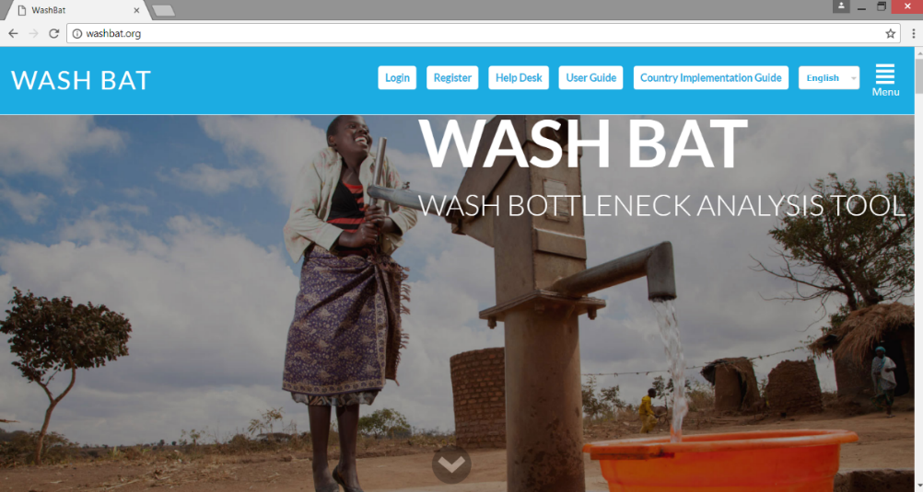
Way Forward
User Resources
Implementation of WASH Bottleneck Analysis on WinS;
Mainstreaming of WinS within the Education sector’s review processes like Joint Action Review (JAR);
Increased advocacy for budget and financing for WinS sustainability and at scale implementation;
Engagement of Private Sectors for continuity of supplies and market access
www.washbat.org

Slide 13
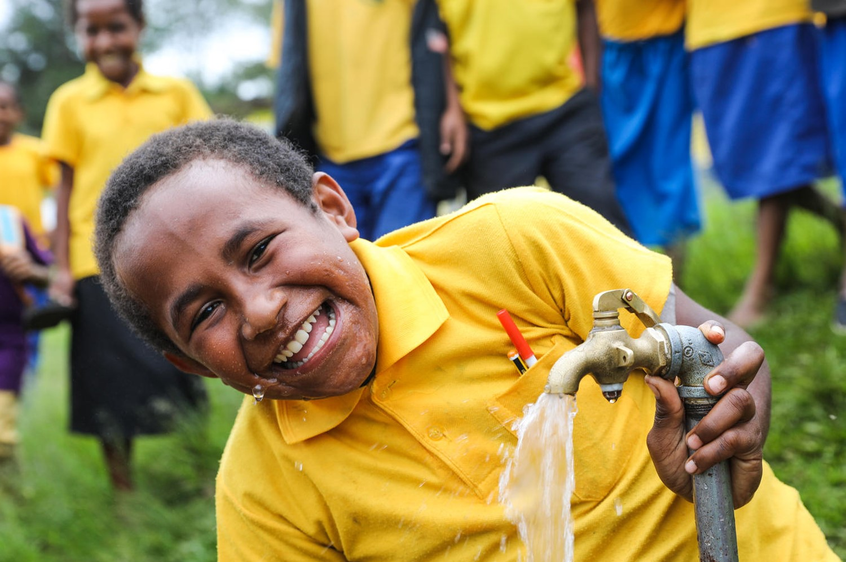
Thank You
© UNICEF/Myanmar

