Slide 1
Global baselines for drinking water, sanitation and hygiene in schools
WHO/UNICEF Joint Monitoring Programme (JMP)
Christie Chatterley
christie.chatterley@gmail.com
washdata.org
7th WASH in Schools ILE, Manila 11 November 2019

Slide 2
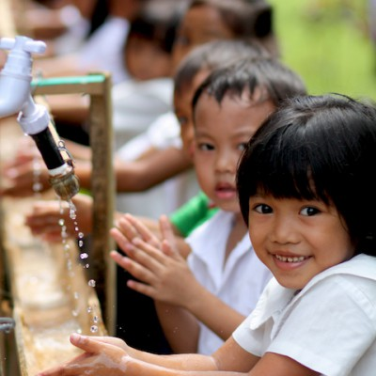
School enrolment has improved, but learning outcomes remain poor (particularly for the disadvantaged)¹ Toilets, water and menstrual products are low-cost, high-impact interventions for improving learning outcomes²
¹ World Development Report 2018: Learning to realize education’s promise. World Bank Group.
² UNICEF (2015) The investment case for education and equity.
Photo from Fit For School Philippines

Slide 3
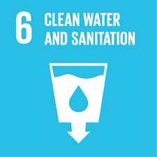
SDGs related to WASH in Schools
6.1 By 2030, achieve universal and equitable access to safe and affordable drinking water for all
6.2 By 2030, achieve access to adequate and equitable sanitation and hygiene for all and end open defecation, paying special attention to the needs of women and girls and those in vulnerable situations
4.a Build and upgrade education facilities that are child, disability and gender sensitive and provide safe, nonviolent, inclusive and effective learning environments for all
4.a.1 Proportion of schools with: …(e) basic drinking water; (f) single-sex basic sanitation facilities; and (g) basic handwashing facilities (as per WASH indicator definitions)
Notes:
SDG6 aims for universal access which goes beyond households and includes WASH in institutional settings
SDG4 has a target on effective learning environments which includes basic drinking water, sanitation and hygiene in schools (WASH definitions are discussed on the next slide)
These targets are mutually reinforcing and call for close collaboration between WASH and Education sectors

Slide 4
New JMP service ladders for WASH in schools*
Drinking Water |  | Sanitation |  | Hygiene
Basic service: Drinking water from an improved source and water is available at the school at the time of the survey |  | Basic service: Improved sanitation facilities at the school that are single-sex and usable (available, functional and private) at the time of the survey |  | Basic service: Handwashing facilities with water and soap available at the school at the time of the survey
Limited service: Drinking water from an improved source but water is unavailable at the school at the time of the survey |  | Limited service: Improved sanitation facilities at the school that are either not single-sex or not usable at the time of the survey |  | Limited service: Handwashing facilities with water but no soap available at the school at the time of the survey
No service: Drinking water from an unimproved source or no water source at the school |  | No service: Unimproved sanitation facilities or no sanitation facilities at the school |  | No service: No handwashing facilities available or no water available at the school
*“Schools” includes pre-primary, primary and secondary schools
Notes:
The new JMP ladders focus on progress towards a basic level of drinking water, sanitation and hygiene service in schools which is the indicator used for SDG monitoring
Agreed upon by Expert Group representing multiple regions and organizations, including UNESCO-UIS.

Slide 5
Which countries provided data for the baseline report?
Country | Basic Water | Basic Sanitation | Basic Hygiene
Afghanistan
Bangladesh
Bhutan
Cambodia
China
Cook Islands
DPR Korea
Fiji
India
Indonesia
Kiribati
Lao PDR
Malaysia
Maldives
Marshall Islands
Micronesia
Mongolia
Myanmar
Country | Basic Water | Basic Sanitation | Basic Hygiene
Nauru
Nepal
Niue
Pakistan
Palau
Papua New Guinea
Philippines
Samoa
Solomon Islands
Sri Lanka
Thailand
Timor-Leste
Tokelau
Tonga
Tuvalu
Vanuatu
Viet Nam
Notes:
Majority come from EMIS, followed by school surveys and censuses
A significant amount of data came from the SA and EAP regions with 12 countries able to report on all three elements of basic services (water, sanitation, and hygiene)

Slide 6
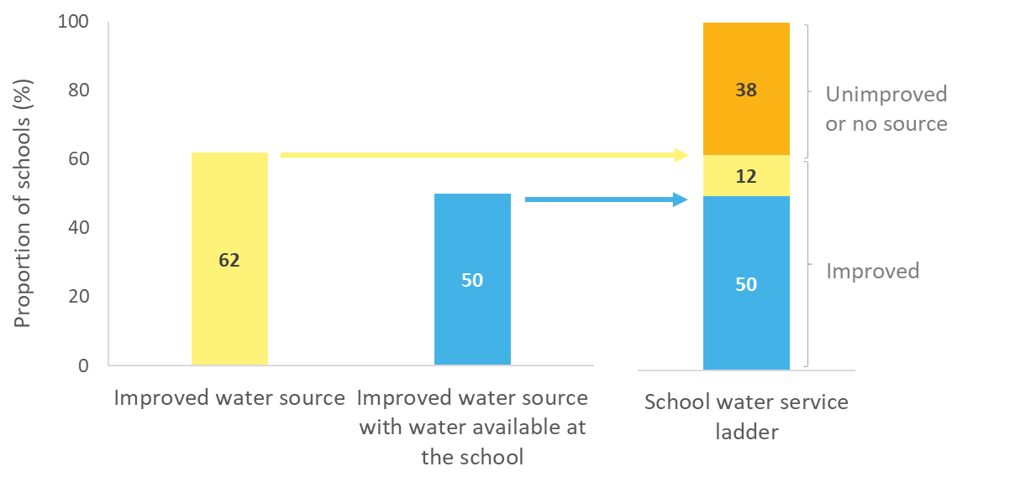
Example: Constructing drinking water ladder in the Philippines

Slide 7
Basic drinking water in schools
Estimates for 15 countries in the EAP and SA regions, 4 of which are <50%
20 countries had insufficient data to estimate basic service
Notes:
Only 15 countries in EAP and SA had sufficient data to estimate coverage of basic services in 2016. <50% of schools in four of the 15 countries. 7 are below the global average.

Slide 8
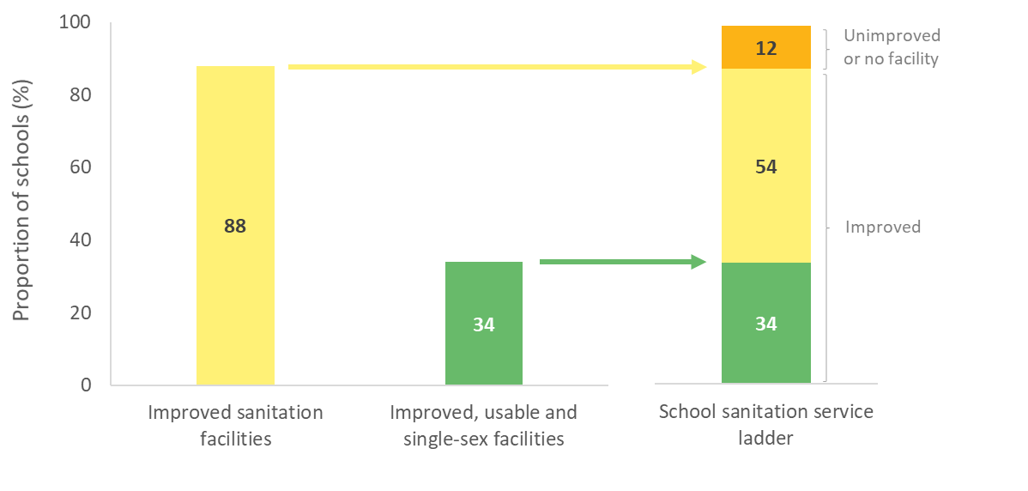
Example: Constructing sanitation ladder in Indonesia

Slide 9
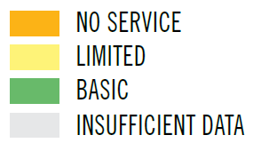
Basic sanitation in schools
Estimates for 15 countries in the EAP and SA regions, 6 of which are <50%
20 countries had insufficient data to estimate basic service
Notes:
Only 15 countries in EAP and SA had sufficient data to estimate coverage of basic services in 2016. Coverage is less than 50% in 6 of the 15.
8 are below the global average.

Slide 10
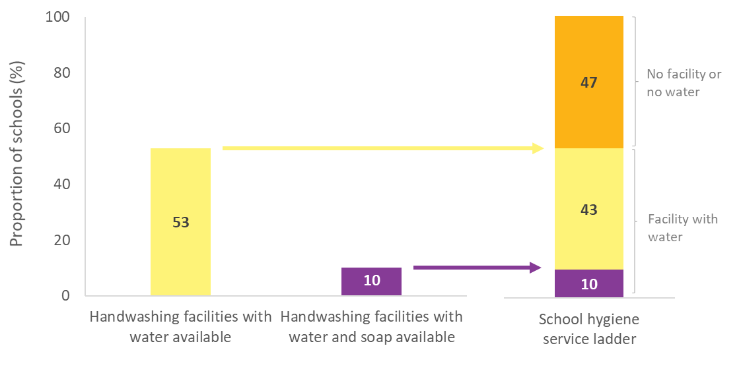
Example: Constructing hygiene ladder in Papua New Guinea

Slide 11
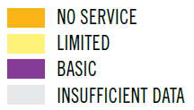
Basic hygiene in schools (2016)
Estimates for 13 countries in the EAP and SA regions, of which 8 are <50%
22 countries had insufficient data to estimate basic service
Notes:
Only 15 countries in EAP and SA had sufficient data to estimate coverage of basic services in 2016. 8 of which are <50% and below the global average.

Slide 12
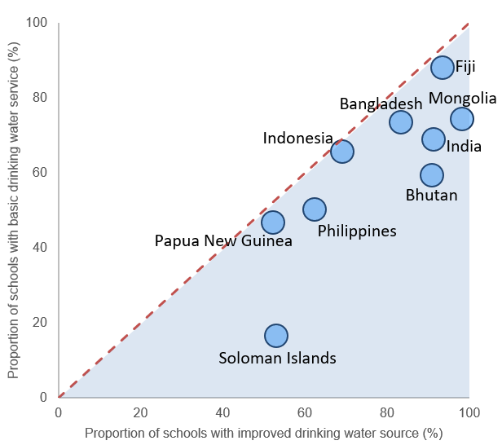
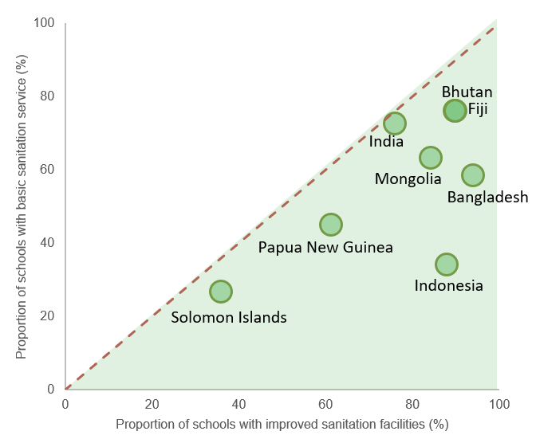
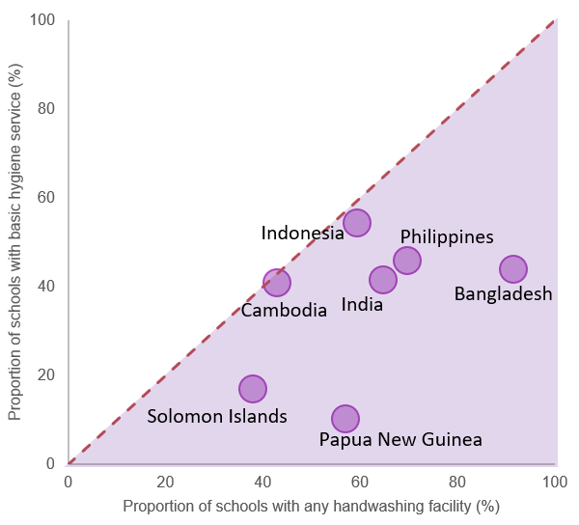
Many schools have facilities that do not meet the SDG criteria for a basic service
Basic = improved & available
Basic = improved, usable & single-sex
Basic = facility with water & soap
Improved vs basic drinking water
Improved vs basic sanitation
Any facility vs basic hygiene
Notes:
These graphs shows that while many schools have infrastructure, not all of them meet the criteria for basic services
In countries which fall below the line, the proportion of schools with improved water and sanitation and handwashing facilities is higher than the proportion of schools with water, sanitation and hygiene basic services

Slide 13
Inequalities in basic service between primary and secondary schools
Global averages for primary schools are lower than secondary schools
Notes:
Very few countries have data disaggregated by primary / secondary
For some countries difference is small, for some big difference, such as Papua New Guinea for water and sanitation, but not hygiene, whereas in Indonesia there is a fairly consistent gap for all 3 indicators. In the Philippines primary schools have higher coverage for hygiene than secondary schools.
Where we do have data on pre-primary it’s often even lower than primary schools

Slide 14
Inequalities in basic service between primary and secondary schools
Coverage is typically lower in rural areas
Notes:
Even fewer countries have data disaggregated by urban/rural
Coverage is typically lower in rural areas
For some countries difference is small (e.g. India), for some big difference, such as Mongolia.

Slide 15
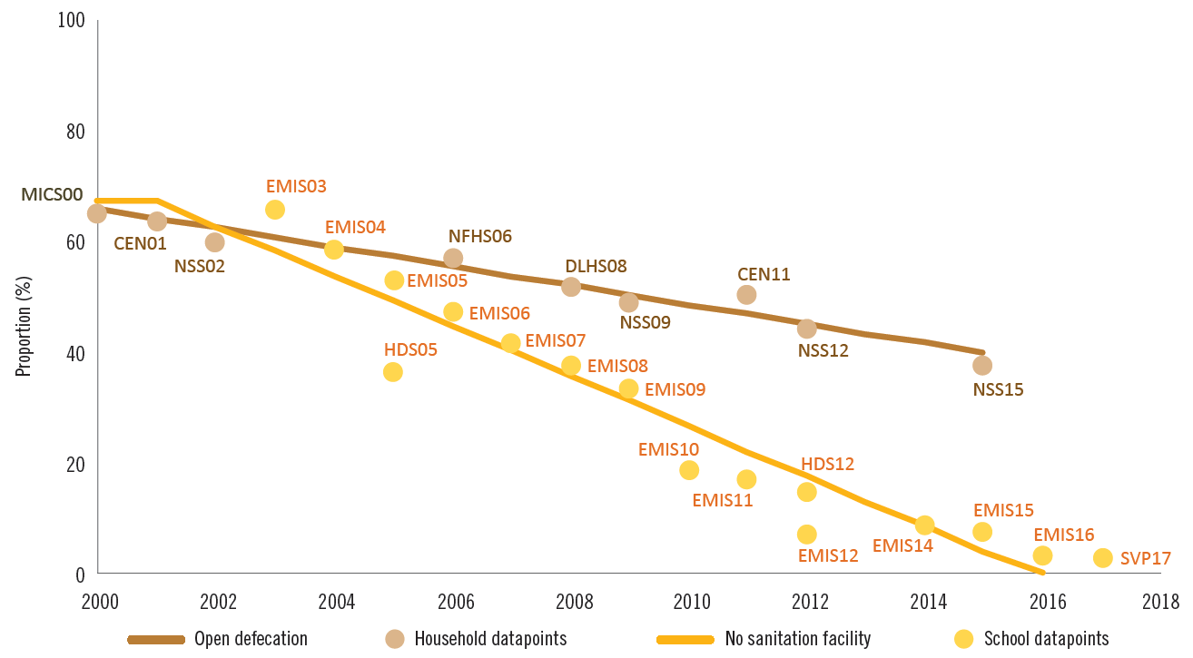
Progress towards universal access at home and in schools
India has made rapid progress in increasing access to sanitation in schools
Proportion of the population practising open defecation and proportion of schools with no sanitation facility, India, 2000–16 (%)
Notes:
JMP can now combine data for WASH services at home and WASH in institutions
Slide shows relative rates of reduction in open defecation (no household facility) and reduction in the number of schools with no sanitation facility in India since 2000
Based on these trends, the JMP estimates that almost all schools in India had some type of sanitation facility in 2016, while 10 years earlier half the schools in India reported having no sanitation facility at all.

Slide 16
Progress toward meeting the SDGs for WinS
Very few countries have sufficient data to produce basic service trends
Where we can calculate trends, we are often off-track to meet the SDGs
Gap
Gap

Slide 17
New JMP service ladders for WASH in schools
Drinking Water |  | Sanitation |  | Hygiene
Advance service: Additional criteria may include quality, quantity, continuity, and accessibility to all users |  | Advanced service: Additional criteria may include student per toilet ratios, menstrual hygiene facilities, cleanliness, accessibility to all users, and excreta management systems |  | Advanced service: Additional criteria may include hygiene education, group handwashing, menstrual hygiene materials, and accessibility to all users
Basic service: Drinking water from an improved source and water is available at the school at the time of the survey |  | Basic service: Improved sanitation facilities at the school that are single-sex and usable (available, functional and private) at the time of the survey |  | Basic service: Handwashing facilities with water and soap available at the school at the time of the survey
Limited service: Drinking water from an improved source but water is unavailable at the school at the time of the survey |  | Limited service: Improved sanitation facilities at the school that are either not single-sex or not usable at the time of the survey |  | Limited service: Handwashing facilities with water but no soap available at the school at the time of the survey
No service: Drinking water from an unimproved source or no water source at the school |  | No service: Unimproved sanitation facilities or no sanitation facilities at the school |  | No service: No handwashing facilities available or no water available at the school
Notes:
It is recognised that this basic minimum level of service is not sufficient for full realization of the human rights to education, safe water and sanitation and that additional rungs may be needed in future to monitor advanced service levels
The JMP 2018 global report on WASH in schools includes a section on emerging data for enhanced monitoring of advanced service levels.
The following provides just a few examples following the normative criteria of the human rights to safe water and sanitation i.e. accessibility, availability, quality and acceptability

Slide 18
Examples of monitoring advanced service levels
Few countries had data on advanced elements
Notes:
Examples

Slide 19
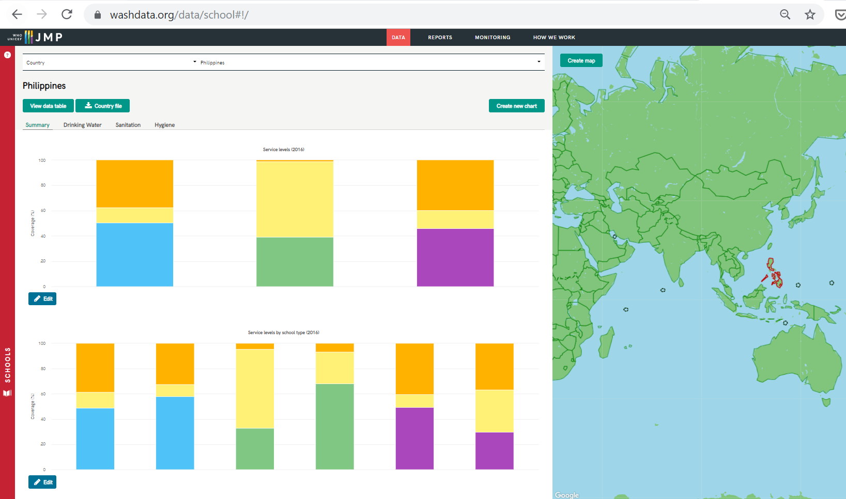
Interactive data are available at www.washdata.org/data/school#!/
Notes:
Some countries have very few data points available making it difficult to estimate trends

Slide 20
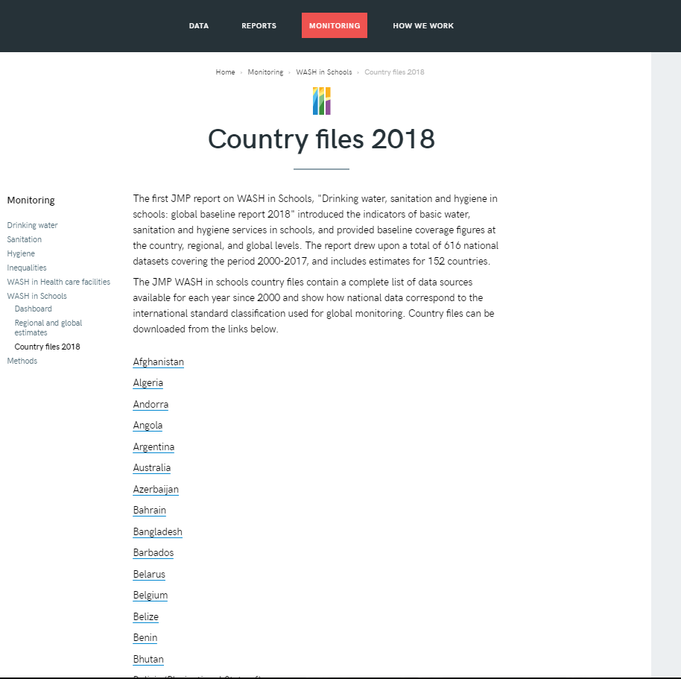
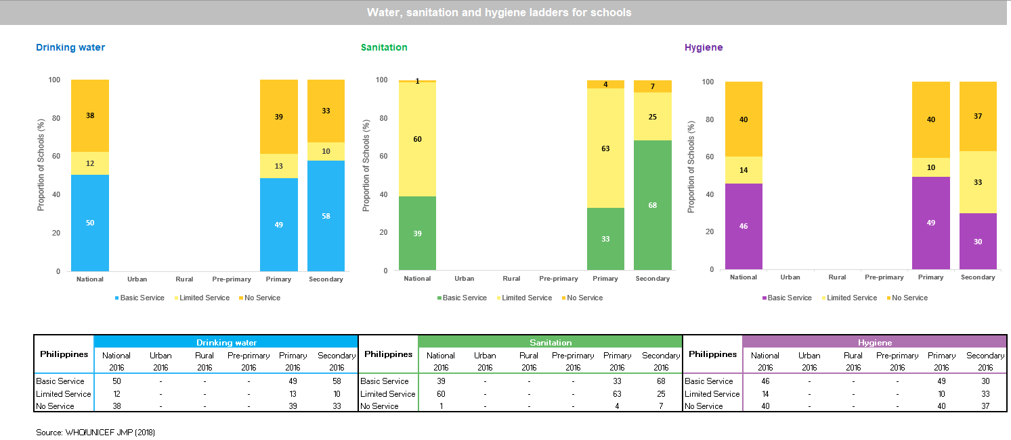
New JMP country files for WASH in Schools x 152
https://washdata.org/monitoring/schools/country-files-2018
Notes:
Country files are available online for 152 countries including detailed data and sources that were used and assumptions made
Some countries have very few data points available making it difficult to estimate trends

Slide 21
Who will have data in the 2020 report?
Country | Basic Water | Basic Sanitation | Basic Hygiene
Afghanistan
Bangladesh | trend | trend
Bhutan | trend
Cambodia
China
Cook Islands
DPR Korea
Fiji
India |  | trend
Indonesia
Kiribati
Lao PDR
Malaysia
Maldives
Marshall Islands
Micronesia
Mongolia
Myanmar
Country | Basic Water | Basic Sanitation | Basic Hygiene
Nauru
Nepal
Niue
Pakistan
Palau
Papua New Guinea
Philippines
Samoa
Solomon Islands
Sri Lanka
Thailand
Timor-Leste
Tokelau
Tonga
Tuvalu
Vanuatu
Viet Nam
Notes:
Some countries that had baseline data may not be included if the data sources are not recent enough to calculate estimates (2015 or later) – e.g. Bangladesh hygiene
Some countries will be able to produce trends toward achieving the SDGs (e.g. Bangladesh, Bhutan, India), but this is insufficient to produce trends for the region.
Additional data ware identified for some countries since the 2018 report (such as SABER17 for Lao PDR)

Slide 22
Are we missing data for your country?
Submit data by the end of 2019 for inclusion in the 2020 WinS report
E-mail info@washdata.org to submit data or request technical support
Country consultations will take place over 6 weeks in early 2020

Slide 23
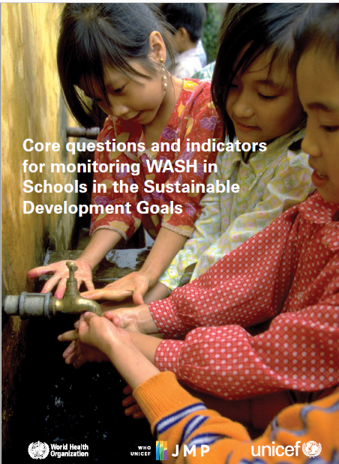
Priority Next Steps
Harmonize definitions & address data gaps for basic services - integrate core questions into national monitoring
Progressively improve WASH services in schools by monitoring advanced services (e.g. MHM)
Drinking Water |  | Sanitation |  | Hygiene
Advanced |  | Advanced |  | Advanced
Basic |  | Basic |  | Basic
Limited |  | Limited |  | Limited
No service |  | No service |  | No service

Slide 24
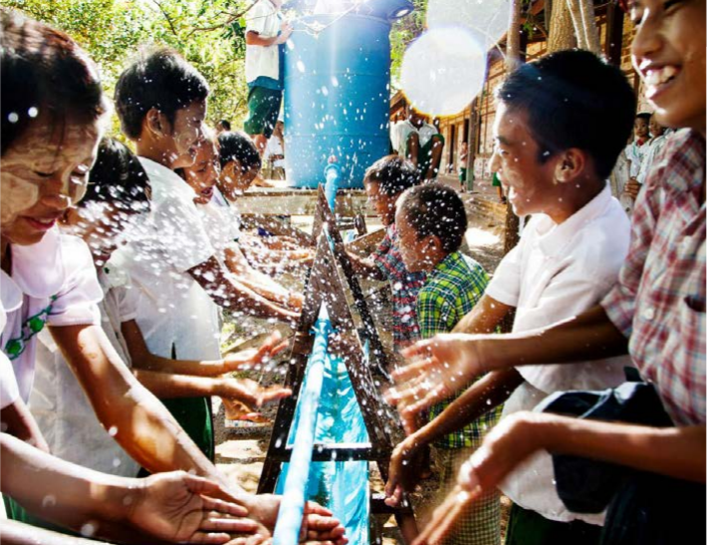
Thank you!
info@washdata.org

Slide 25
Extra slides

Slide 26
Implications - Evariste

Slide 27
New JMP service ladders for WASH in schools
Sanitation
Basic service: Improved sanitation facilities at the school that are single-sex and usable (available, functional and private) at the time of the survey
Limited service: Improved sanitation facilities at the school that are either not single-sex or not usable at the time of the survey
No service: Unimproved sanitation facilities or no sanitation facilities at the school
Notes:
The new JMP ladders focus on progress towards a basic level of drinking water, sanitation and hygiene service in schools which is the indicator used for SDG monitoring
Agreed upon by Expert Group representing multiple regions and organizations, including UNESCO-UIS.

Slide 28
New JMP service ladders for WASH in schools
Hygiene
Basic service: Handwashing facilities with water and soap available at the school at the time of the survey
Limited service: Handwashing facilities with water but no soap available at the school at the time of the survey
No service: No handwashing facilities available or no water available at the school
Notes:
The new JMP ladders focus on progress towards a basic level of drinking water, sanitation and hygiene service in schools which is the indicator used for SDG monitoring
Agreed upon by Expert Group representing multiple regions and organizations, including UNESCO-UIS.

Slide 29
New JMP service ladders for WASH in schools*
Drinking Water |  | Sanitation |  | Hygiene
Basic service: Drinking water from an improved source and water is available at the school at the time of the survey |  | Basic service: Improved sanitation facilities at the school that are single-sex and usable (available, functional and private) at the time of the survey |  | Basic service: Handwashing facilities with water and soap available at the school at the time of the survey
Limited service: Drinking water from an improved source but water is unavailable at the school at the time of the survey |  | Limited service: Improved sanitation facilities at the school that are either not single-sex or not usable at the time of the survey |  | Limited service: Handwashing facilities with water but no soap available at the school at the time of the survey
No service: Drinking water from an unimproved source or no water source at the school |  | No service: Unimproved sanitation facilities or no sanitation facilities at the school |  | No service: No handwashing facilities available or no water available at the school
*“Schools” includes pre-primary, primary and secondary schools
Notes:
The new JMP ladders focus on progress towards a basic level of drinking water, sanitation and hygiene service in schools which is the indicator used for SDG monitoring
Agreed upon by Expert Group representing multiple regions and organizations, including UNESCO-UIS.

Slide 30
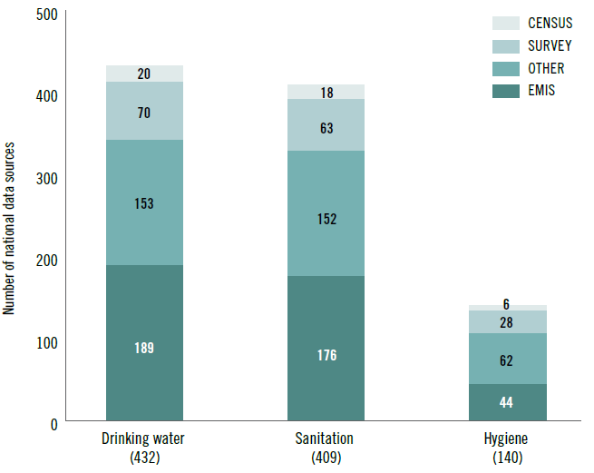
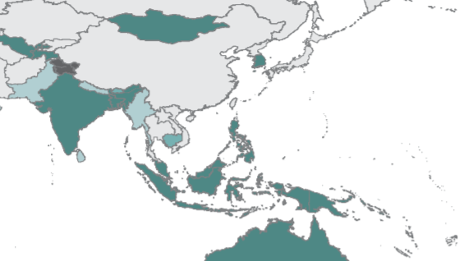
Data sources for the baseline report
A total of 616 national data sources were used
Average of 4 datasets per country
Majority from EMIS
Notes:
A total of 616 national data sources were used for the 2018 baseline report
Average of 4 datasets per country
Majority come from EMIS, followed by other secondary sources (e.g. UNESCO UIS), school surveys and censuses
A significant amount of data came from the SA and EAP regions with some countries already able to report on all three elements of basic services (water, sanitation, and hygiene)

Slide 31
Methods for the baseline estimates
Data mapped to the indicator elements to standardize (as possible)
Estimates are based on linear regression of all data for a particular country
2016 estimate = 68%
Notes:
Data were mapped to the indicator elements to standardize results between surveys and countries to the extent possible

Slide 32
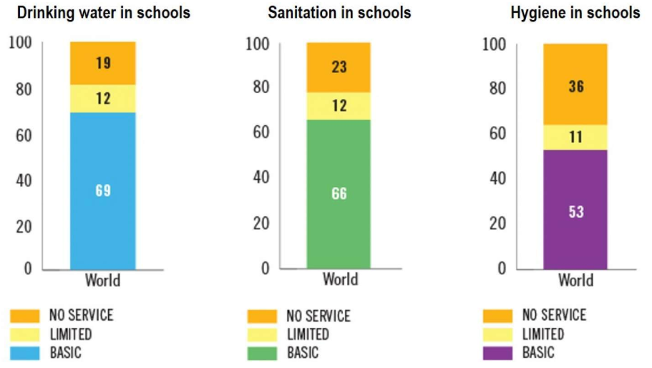
Baseline estimates (2016)
Notes:
The WHO/UNICEF JMP published SDG baseline estimates in 2018 (using 2016 as the reference year).
These are included in the UNESCO GEMR
We will discuss the results for the South Asia and Southeastern Asia and Pacific regions, specifically

Slide 33
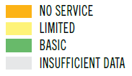
Baseline estimates (2016)
Notes:
The WHO/UNICEF JMP published SDG baseline estimates in 2018 (using 2016 as the reference year).
These are included in the UNESCO GEMR
We will discuss the results for the South Asia and Southeastern Asia and Pacific regions, specifically

Slide 34
Basic drinking water in schools (2016)
Globally, 69% of schools had basic drinking water services
→ 570 million children without basic service
South Asia estimates similar to global situation
Insufficient data from East Asia & Pacific to produce regional estimate of basic service
Notes:
Only 92 countries and 5 out of 8 SDG regions had sufficient data to estimate coverage of basic services in 2016
69% of schools had a basic drinking water service – 570 million children without
<50% of schools in Oceania had a basic service

Slide 35
Basic drinking water in schools (2016)
Notes:
Coverage is wide ranging between countries in the regions

Slide 36
Basic sanitation in schools (2016)
Globally, 66% of schools had basic sanitation service
→ 620 million children without basic service
Nearly 1/3 of schools in East Asia & Pacific have NO sanitation service
Notes:
Oceania: 46, 16, 38

Slide 37
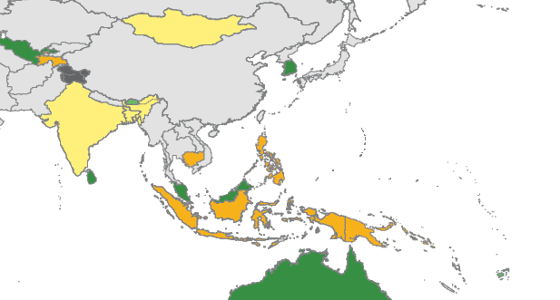
Basic sanitation in schools (2016)
Notes:
Coverage is wide ranging between countries in the region

Slide 38
Basic hygiene in schools (2016)
Globally, 53% of schools had basic hygiene service
→ 900 million children without
Over 1/3 of schools in South Asia have NO handwashing facilities
Insufficient data from East Asia & Pacific to produce regional hygiene estimates

Slide 39
Basic hygiene in schools (2016)
Notes:
Coverage is wide ranging between countries in the regions

Slide 40
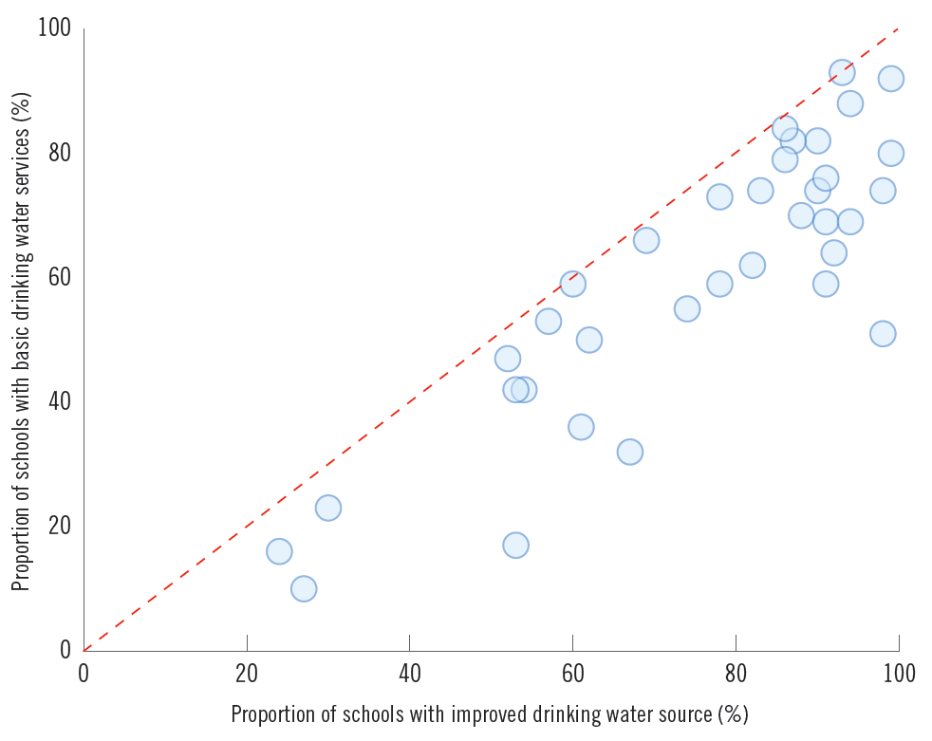
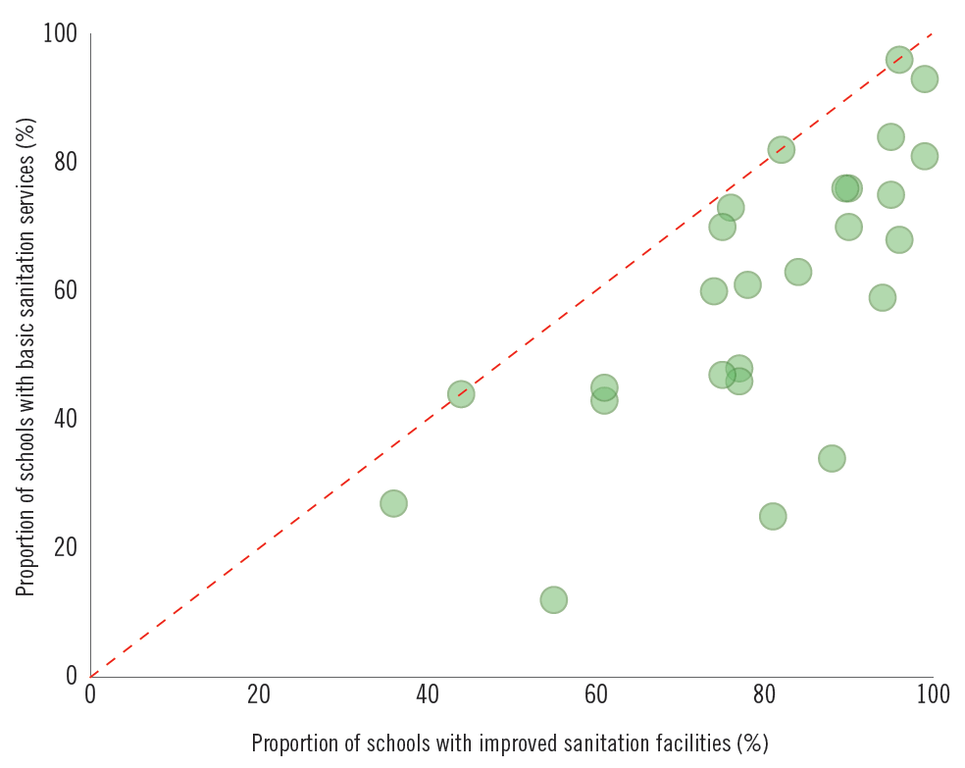
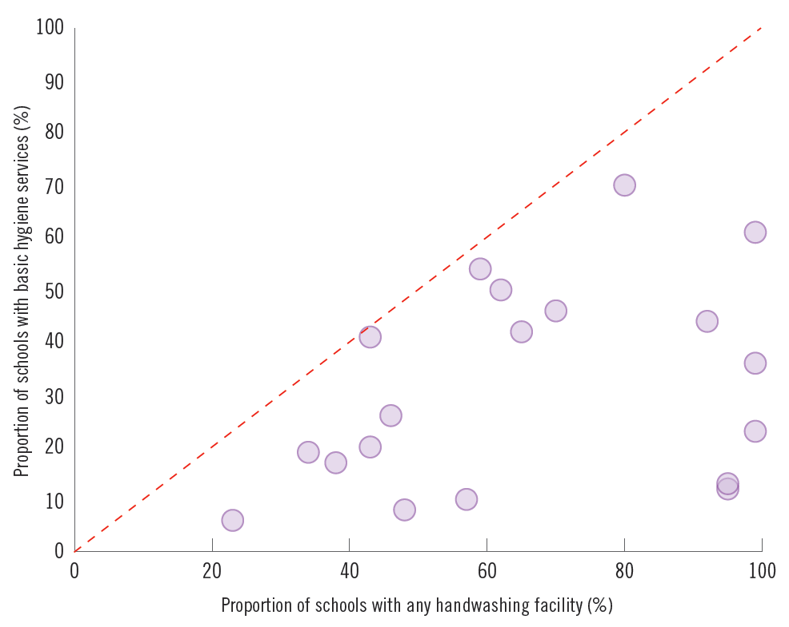
Many schools have facilities that do not meet the SDG criteria for a basic service
Basic = improved & available
Basic = improved, usable & single-sex
Basic = facility with water & soap
9/10 have improved facilities, but only 1/3 usable and single sex
Improved vs basic drinking water
Improved vs basic sanitation
Any facility vs basic hygiene
Notes:
For example, in this country 9 out of 10 schools have improved sanitation facilities but only 1 in 3 meet the criteria for basic.
Highlights the need to focus beyond infrastructure to service provision

Slide 41
Fewer countries have disaggregated data for rural, urban and pre-primary schools
Notes:
In order to monitor inequalities, a focus of the SDGs, we need disaggregated data
This slide shows the number of countries with data available for each type of school or area
Relatively few countries have disaggregated data for pre-primary and for rural and urban
While there is insufficient data for a global estimate in pre-primary schools, for primary and secondary…

Slide 42
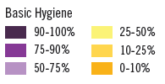
Inequalities between sub-national regions
Notes:
Data for sub-national regions reveal geographic inequalities. PNG provides an example.

Slide 43
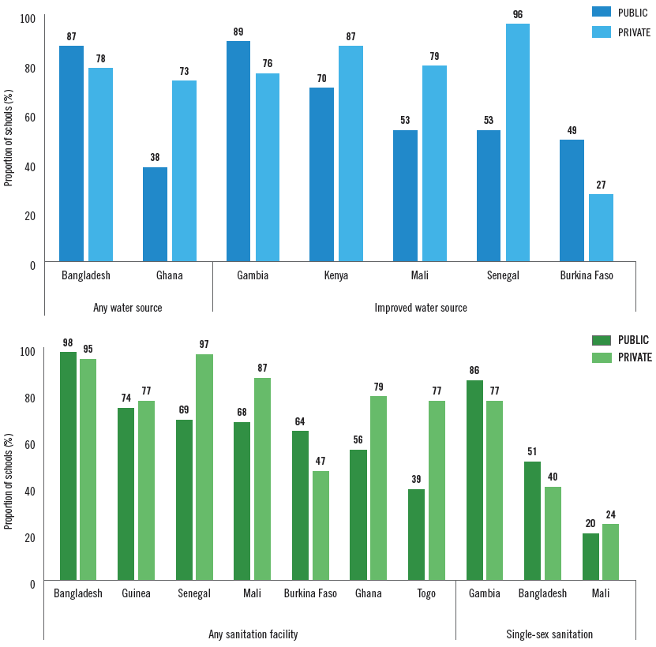
Inequalities between public and private
In Bangladesh, coverage is higher in public schools
Globally, no clear pattern
Notes:
No clear pattern for public vs private
Private schools may range from large elite metropolitan academies to small rural schools run by NGOs

Slide 44
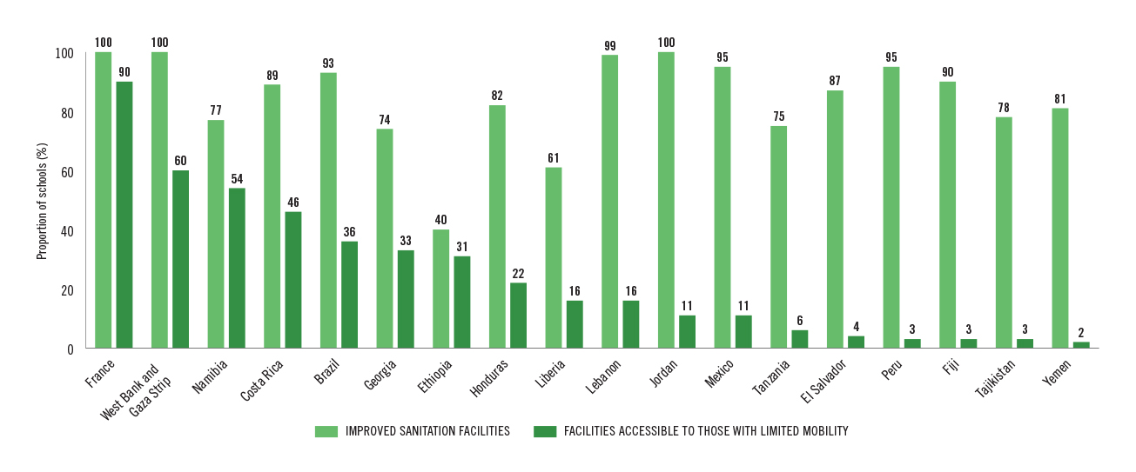
Enhanced monitoring and advanced service levels
Accessibility
In most countries <50% of schools have toilets accessible to students with limited mobility
Notes:
Indicator definitions vary widely between countries limiting realistic cross-country comparison
Fiji is the only country from the region

Slide 45
Enhanced monitoring and advanced service levels
Availability
The ratio of students to toilets often exceeds national guidelines, for both girls and boys
Notes:
The ratio of students to toilets varies across countries but so do national guidelines
In some countries the number of students per toilet far exceeds national guidelines for boys and for girls

Slide 46
Enhanced monitoring and advanced service levels
Acceptability
MHM is included in India’s Swachh Vidyalaya Puraskar data collection:
Nearly 2 out of 3 schools provide MHM education;
More than 1 in 3 have a functional incinerator for disposal of sanitary waste
Notes:
Menstrual hygiene management (MHM) is included in India’s Swachh Vidyalaya Puraskar data collection:
Nearly 2 out of 3 schools provide MHM education;
More than 1 in 3 have a functional incinerator for disposal of sanitary waste

Slide 47
Priority Next Steps
Drinking Water |  | Sanitation |  | Hygiene
Advanced |  | Advanced |  | Advanced
Basic |  | Basic |  | Basic
Limited |  | Limited |  | Limited
No service |  | No service |  | No service
Harmonize definitions & address data gaps - integrate core questions into national monitoring
Notes:
Adoption of the core questions by survey programs and national governments can facilitate this process

Slide 48
Priority Next Steps
Drinking Water |  | Sanitation |  | Hygiene
Advanced |  | Advanced |  | Advanced
Basic |  | Basic |  | Basic
Limited |  | Limited |  | Limited
No service |  | No service |  | No service
Harmonize definitions & address data gaps - integrate core questions into national monitoring
Extend basic service to ALL schools
Notes:
Adoption of the core questions by survey programs and national governments can facilitate this process

Slide 49
Priority Next Steps
Drinking Water |  | Sanitation |  | Hygiene
Advanced |  | Advanced |  | Advanced
Basic |  | Basic |  | Basic
Limited |  | Limited |  | Limited
No service |  | No service |  | No service
Harmonize definitions & address data gaps - integrate core questions into national monitoring
Extend basic service to ALL schools
Progressively improve WASH services in schools by monitoring advanced services (e.g. MHM)
Notes:
Adoption of the core questions by survey programs and national governments can facilitate this process

